Slide 1
JCS-Manzanita
School Site Council
November 5, 2025

Slide 2
Welcome
Don't forget…
We are SO grateful for your attendance and participation!
Please introduce yourself to the group. What is your role as a JCS partner?

Slide 3
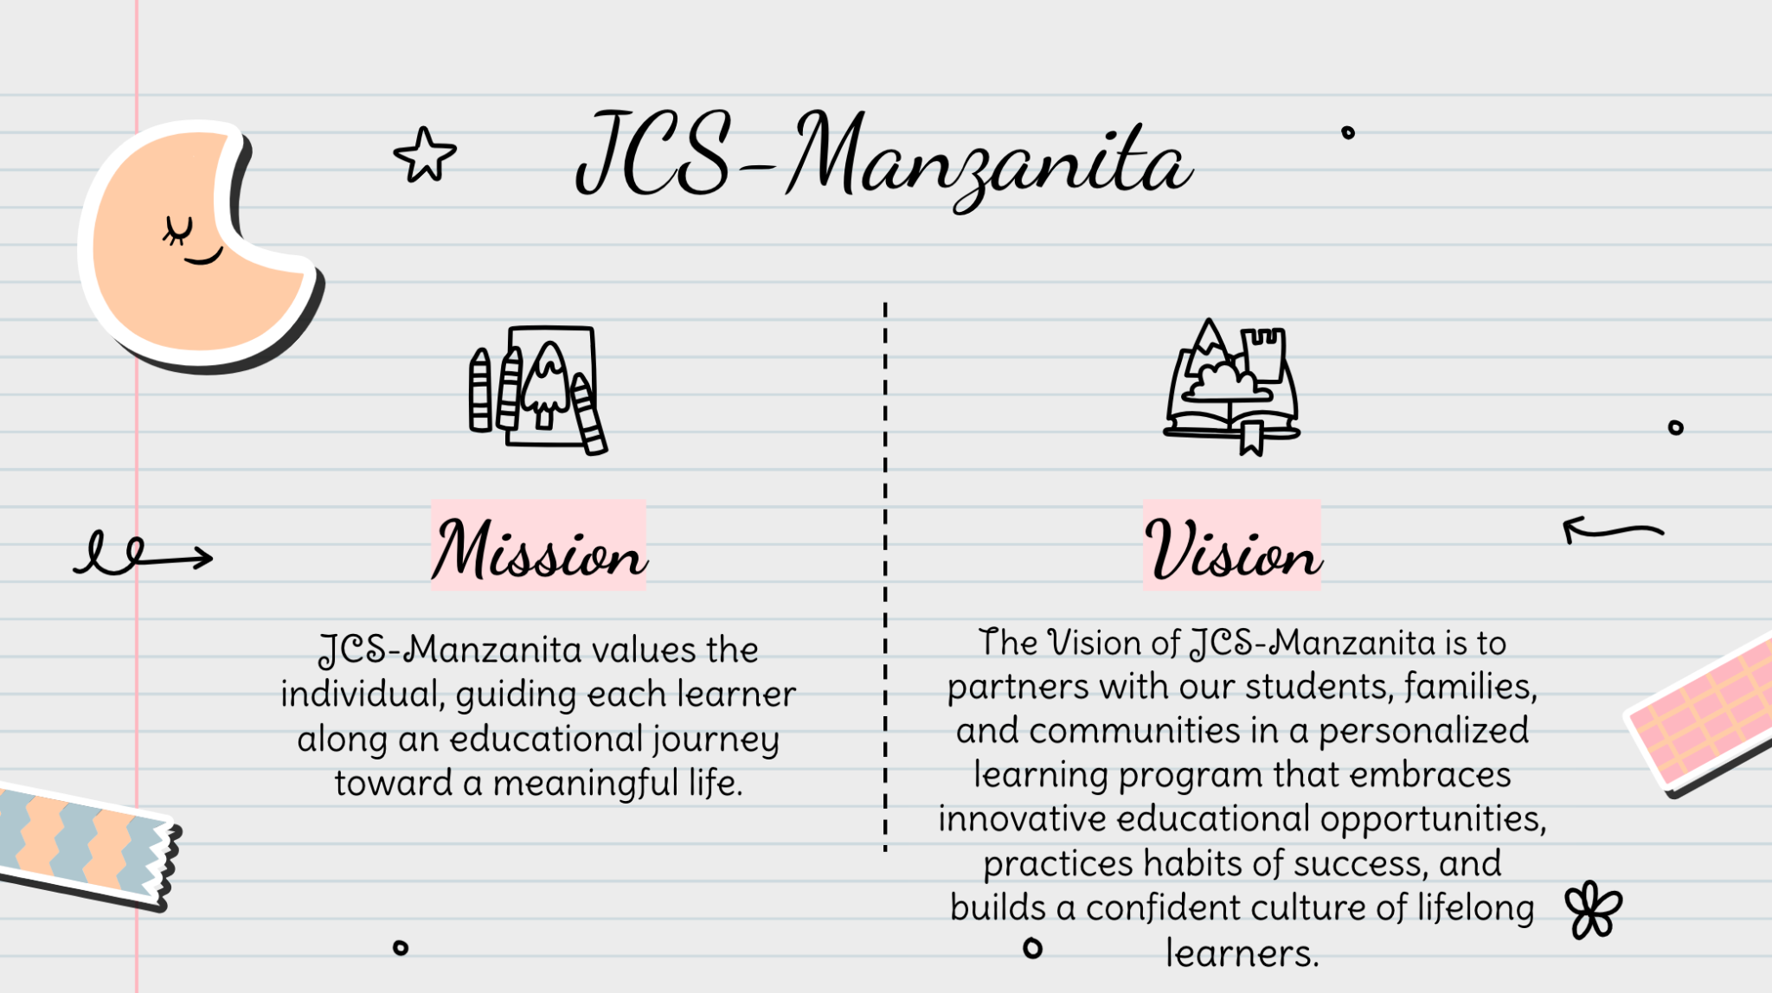

Slide 4
Meeting Objectives
School Improvement
Transparency
Partnership
“Unity is Strength…where there is Teamwork and Collaboration, wonderful things can be achieved!”
-Mattie Stepanek, American Teenage Poet

Slide 5
Agenda
Opening Items
Discussion Items
We are here.
Welcome/Introductions
Mission/Vision
Meeting Objectives
Agenda Preview
Comments Regarding Items NOT on the Agenda
Budget & Enrollment Overview
JCS Board Reports & School Update
LREBG Needs Assessment & Partner Input
Additional Student Data
LCAP Overview & Partner Engagement
Superintendent Selection Committee
Safety Plan Review & Input
Arts & Music Grant (Prop 28) Plan
26/26 Calendar Review & Input
Round Table Discussion

Slide 6
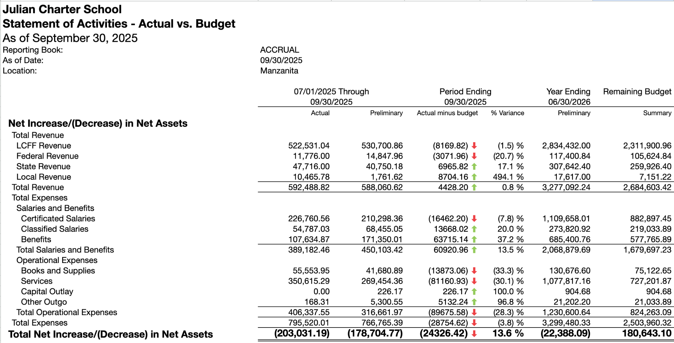
Budget Summary: YTD Actuals
Note: Budget is based on a projected enrollment of 240 students and 97% ADA. The school receives approximately $10,000/student; therefore, not hitting our enrollment goal can impact the budget significantly. 1st interim budget revisions will reflect actual enrollment number revenue.
Notes:
This report is as of Sept. 30, 2025, compared against our Adopted Budget, based on 240 students enrolled and enrollment ADA of 232.80. YTD Revenues through Sept. 30, 2025, are $592,488.82 or 0.8% over our current budget. YTD Expenses are $795,520.01 or 3.8% under our current budget due to some underspending in Books and Supplies and Services. This was offset by some overspending in Personnel Expenses. Therefore, net income is ($203,031.19) or 13.6% under our current budget.

Slide 7
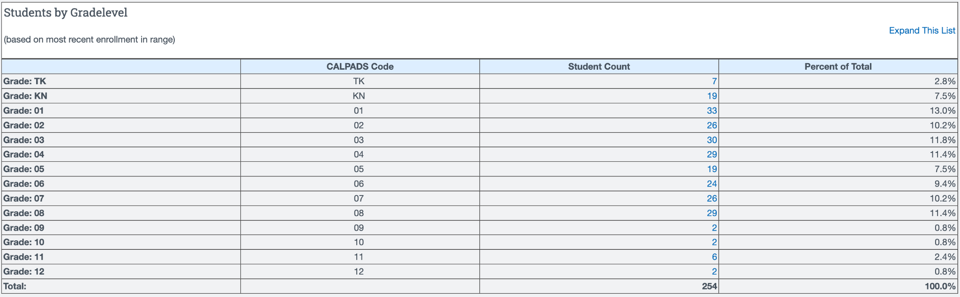
Enrollment Summary (as of 11/3/25)
11/3/2024 Enrollment (Last Year): 238
11/3/2025 Enrollment (This Year): 254
Enrollment Goal: 240

Slide 8
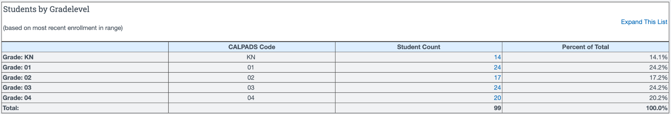
K-4 Academy Enrollment Summary
11/3/2024 Enrollment (Last Year): 99
11/3/2025 Enrollment (This Year): 99
Difference: 0

Slide 9
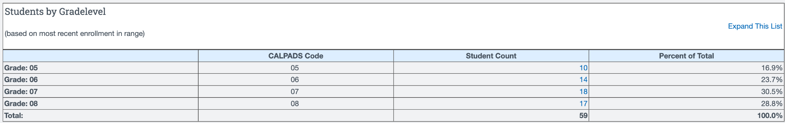
5-8 Academy Enrollment Summary
11/3/2024 Enrollment (Last Year): 57
11/3/2025 Enrollment (This Year): 59
Difference: 2

Slide 10
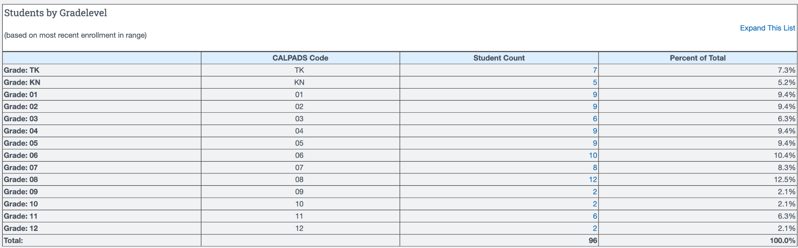
Home Study Enrollment Summary
11/3/2024 Enrollment (Last Year): 82
11/3/2025 Enrollment (This Year): 96
Difference: 14

Slide 11
Board Reports
August 2025
September 2025
October 2025
Please attend the next JCS Board Meeting on Friday, November 7, 2025 @ 10 a.m. via Zoom (access at JCS-Inc.org)

Slide 12

School Highlights
Annual Welcome Back Picnic
Enrollment Growth & Budget
New Staff (3rd grade, Science, SPED)
Beyond on Fridays
Friday Field Trips
Extended School Services (ESS)
PTO & Events (Movie Night, Fall Festival)
Center for World Music
Book Fair & Fundraising
Parent Teacher Conferences
Spirit Days, Elective Blocks, Manza Mixers
Attendance Wristbands & Charms
Not So Highlights
Sheryl teaching full-time
Williams Act Monitoring
Reduced staff

Slide 13

LREBG Needs Assessment & Partner Input
Click Here

Slide 14

Additional Student Data
2025 CAASPP Data Comparison

Slide 15
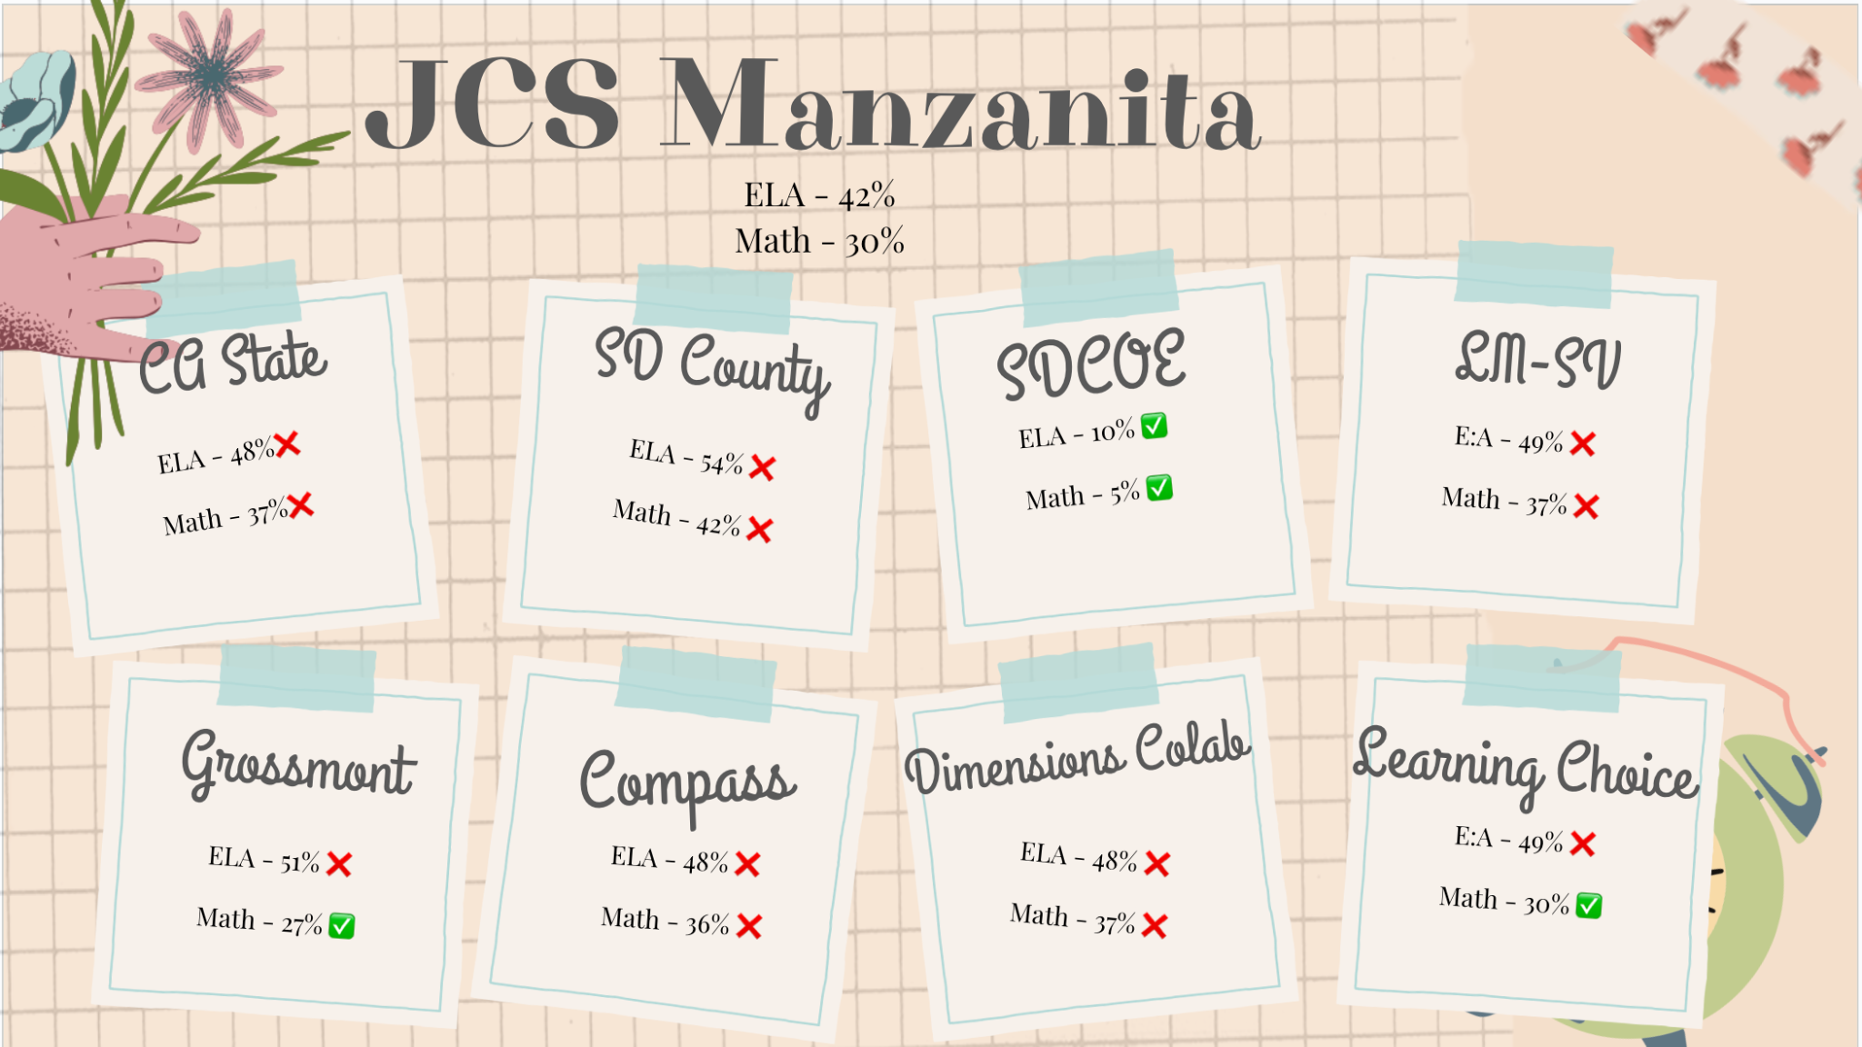
Additional Student Data
2025 CAASPP Data Comparison

Slide 16
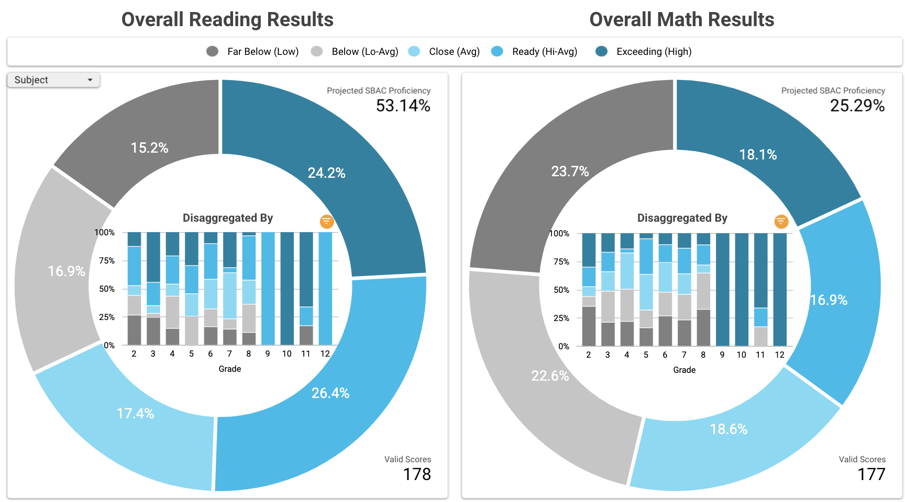
Additional Student Data
Fall 2025 NWEA MAP Data

Slide 17
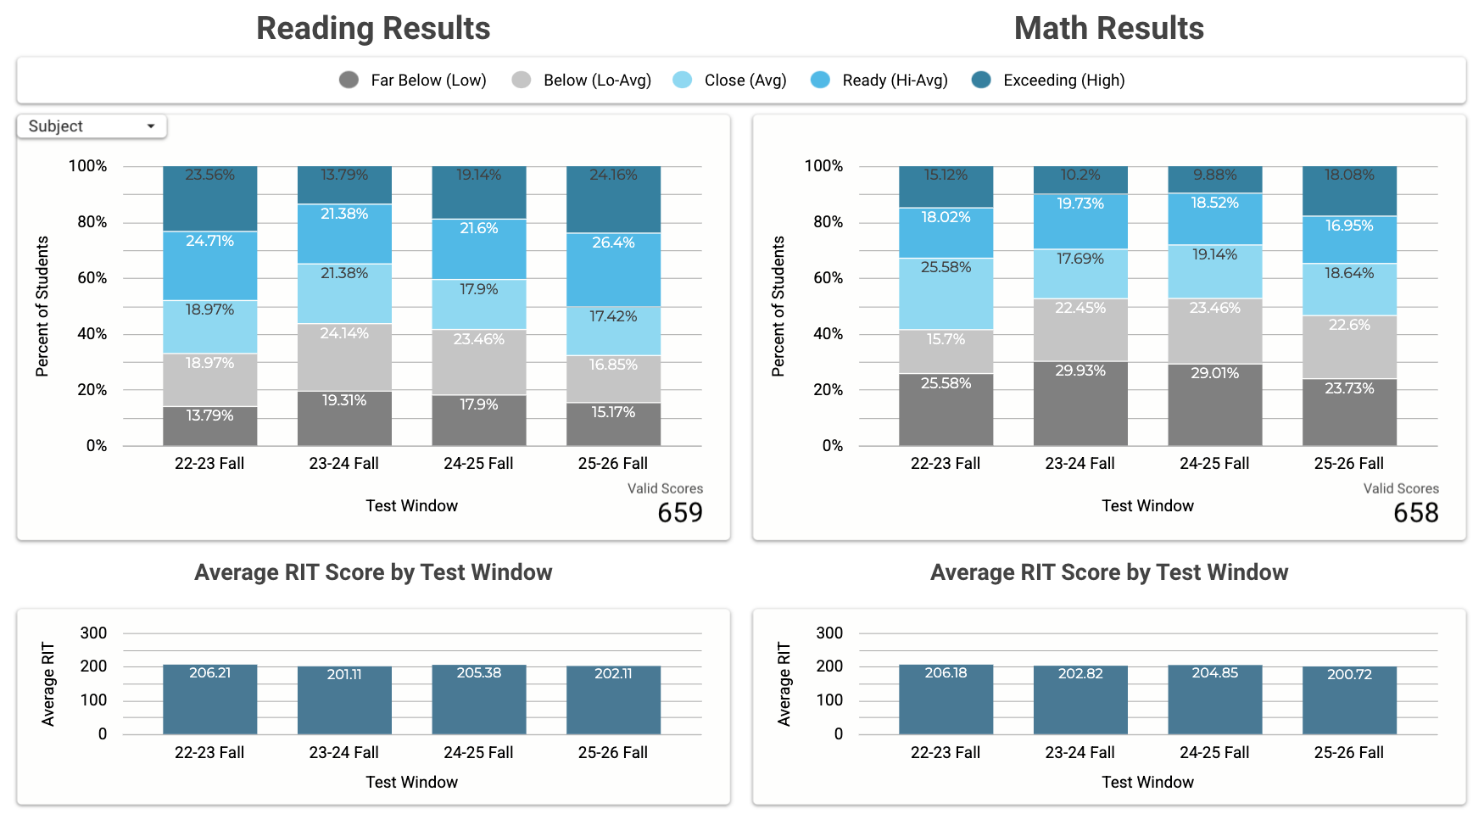
Additional Student Data
Fall NWEA MAP Data - Trends Over Time

Slide 18
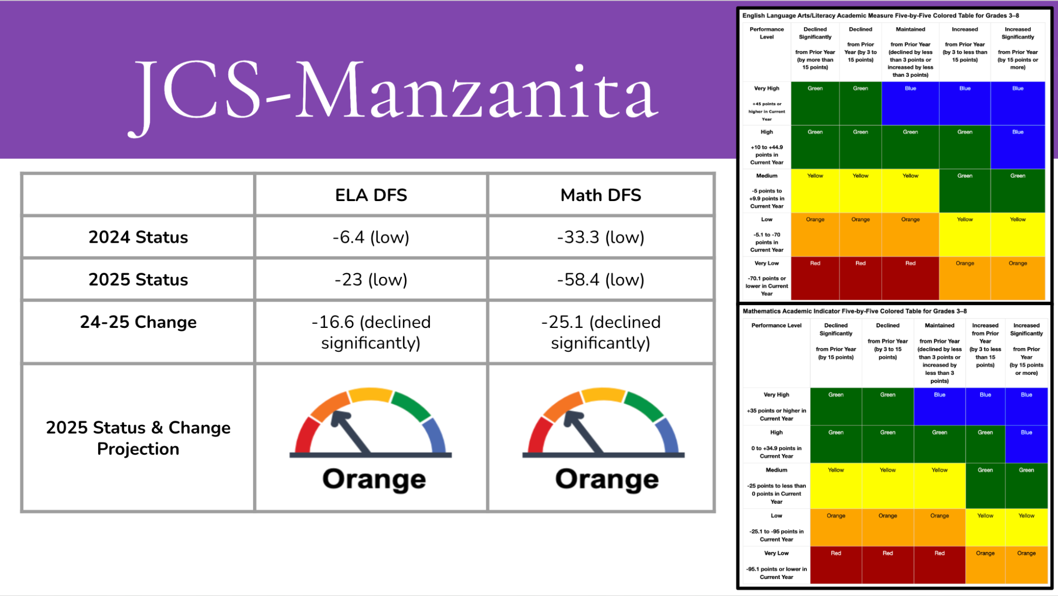
Additional Student Data
2025 CA School Dashboard Projections
  CA Schools Dashboard public release is expected on November 15, 2025.
  Click here to learn more about the CA Schools Dashboard.

Slide 19
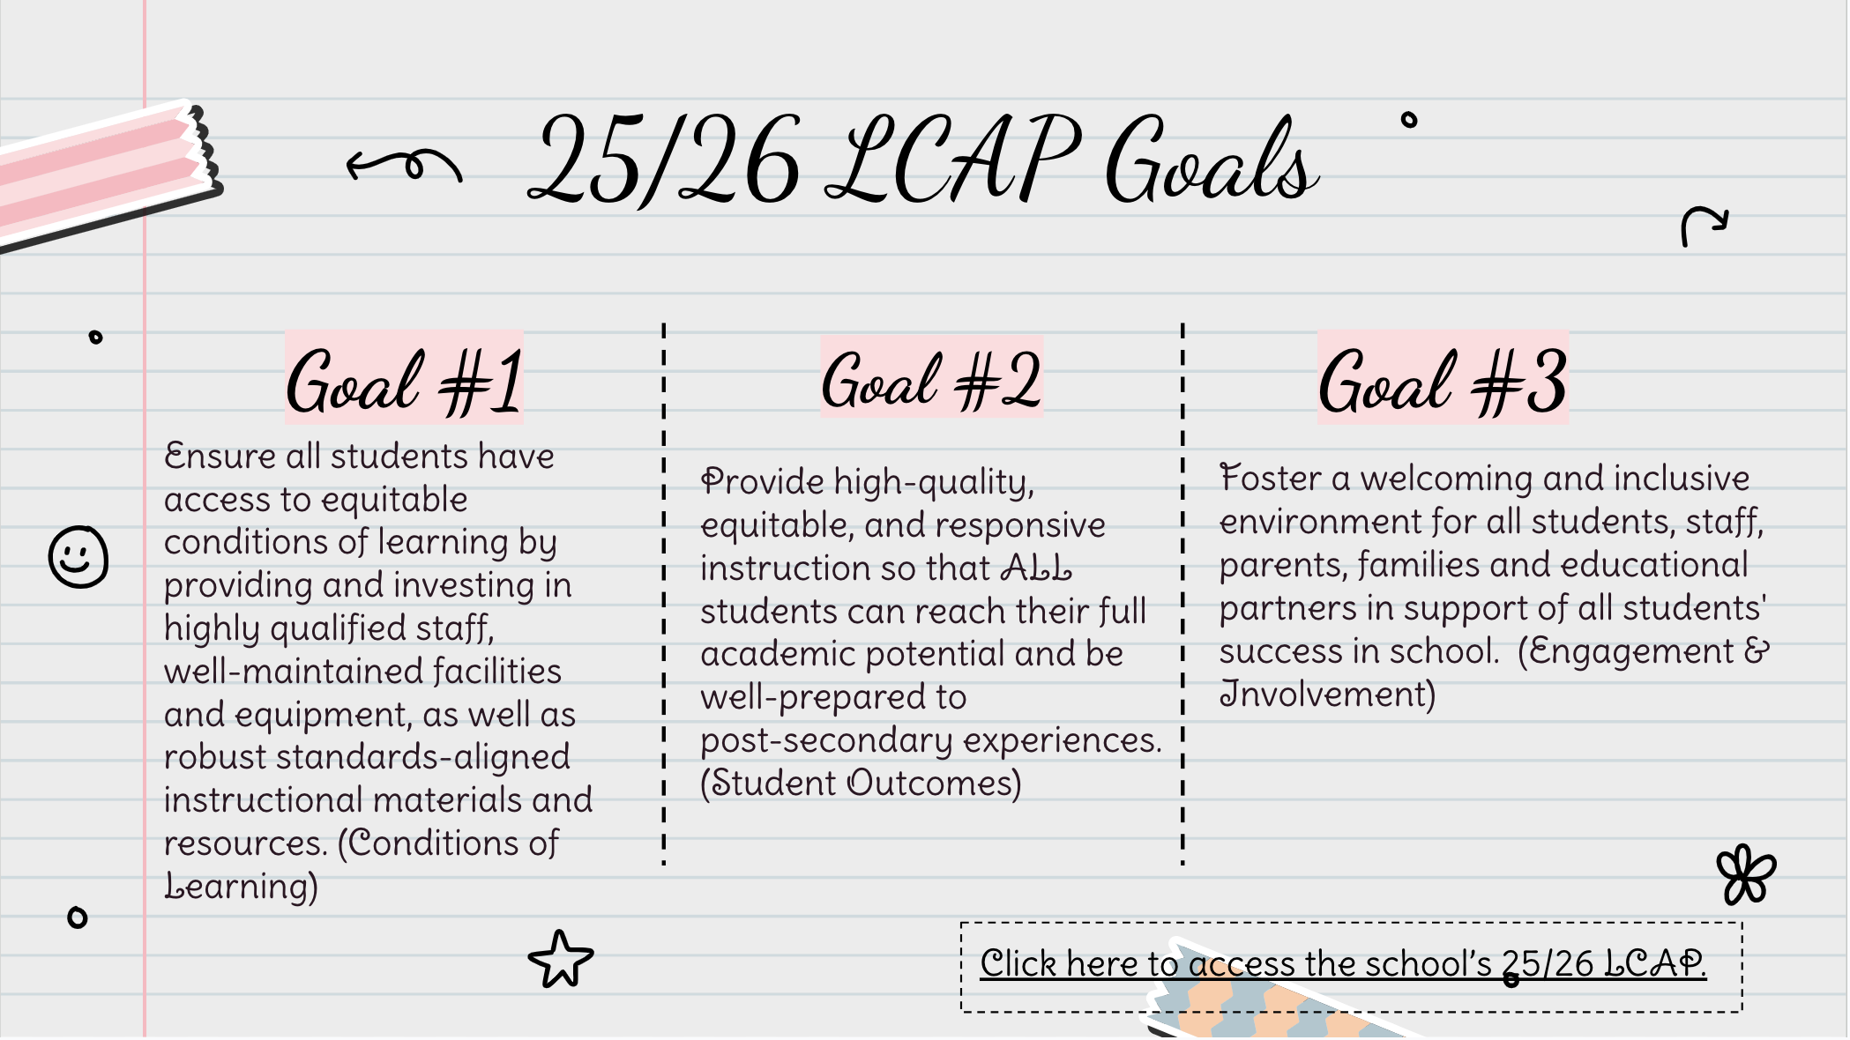

Slide 20
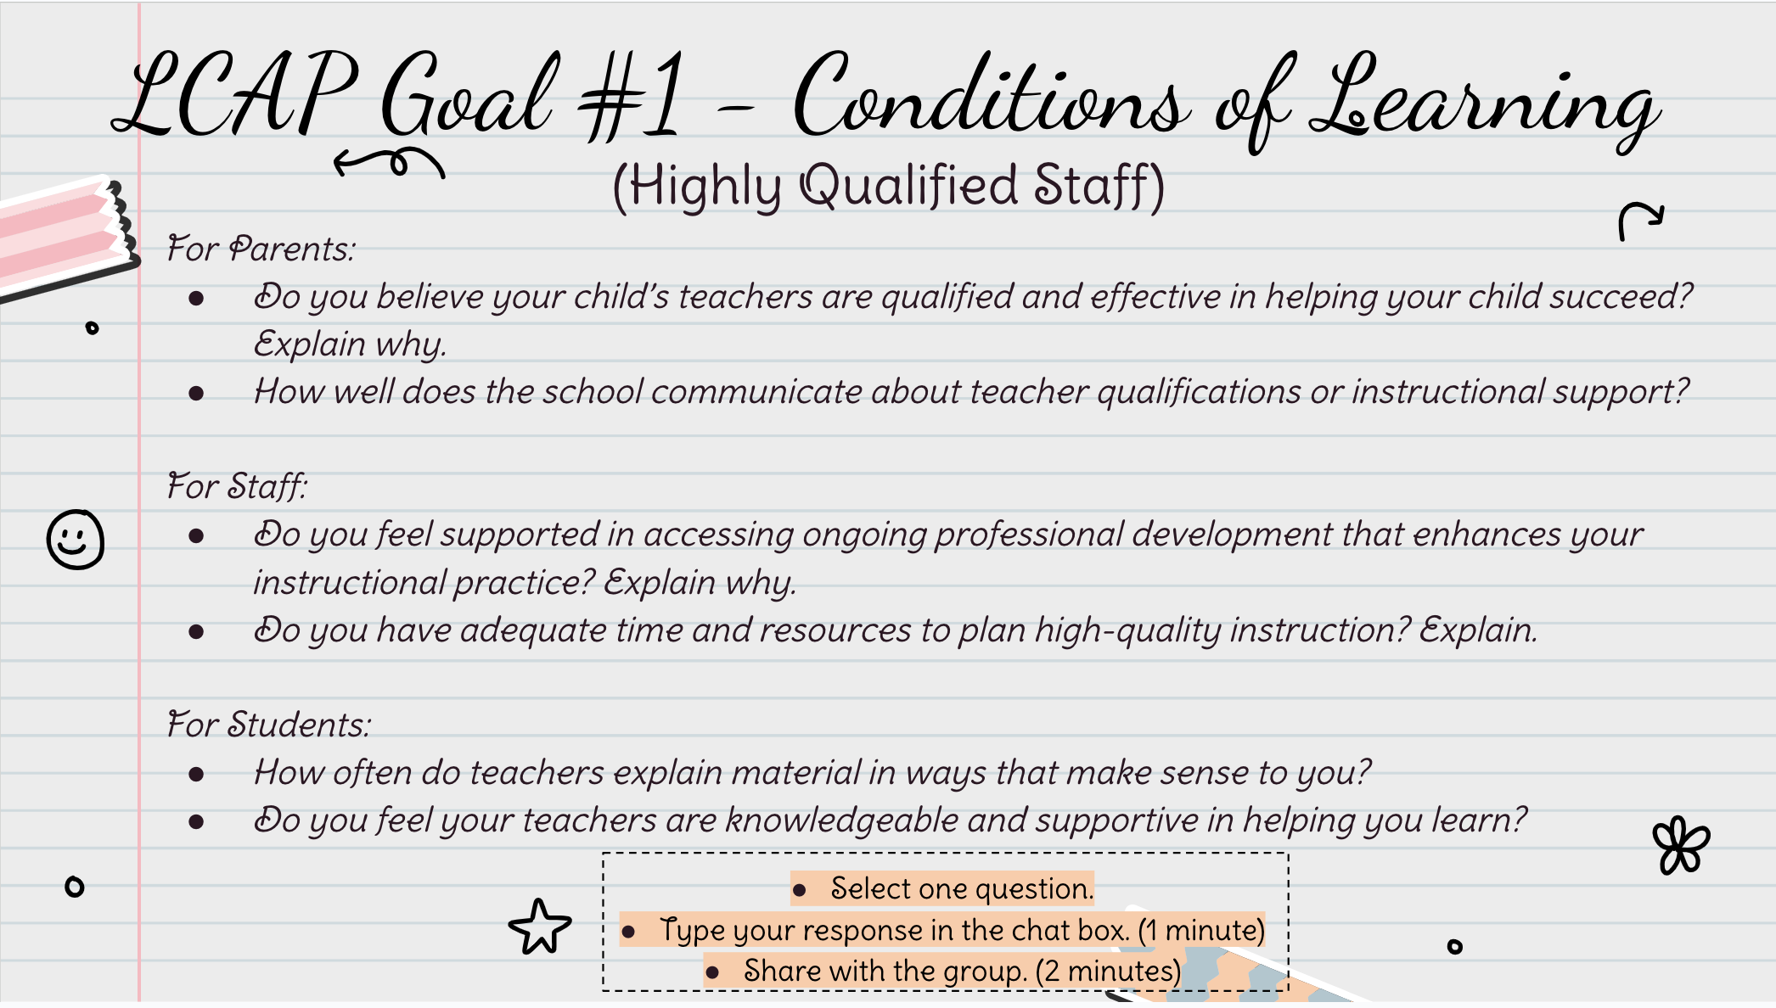

Slide 21
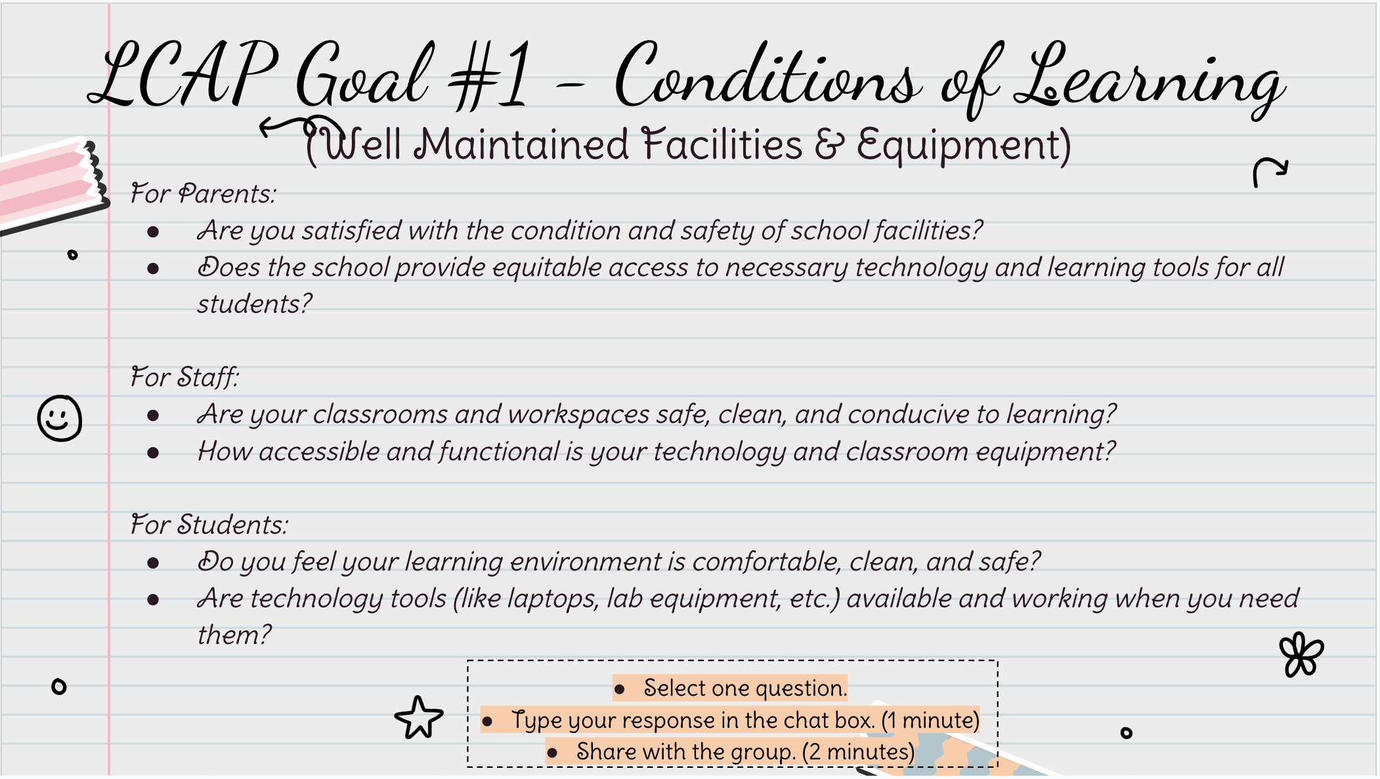

Slide 22


Slide 23
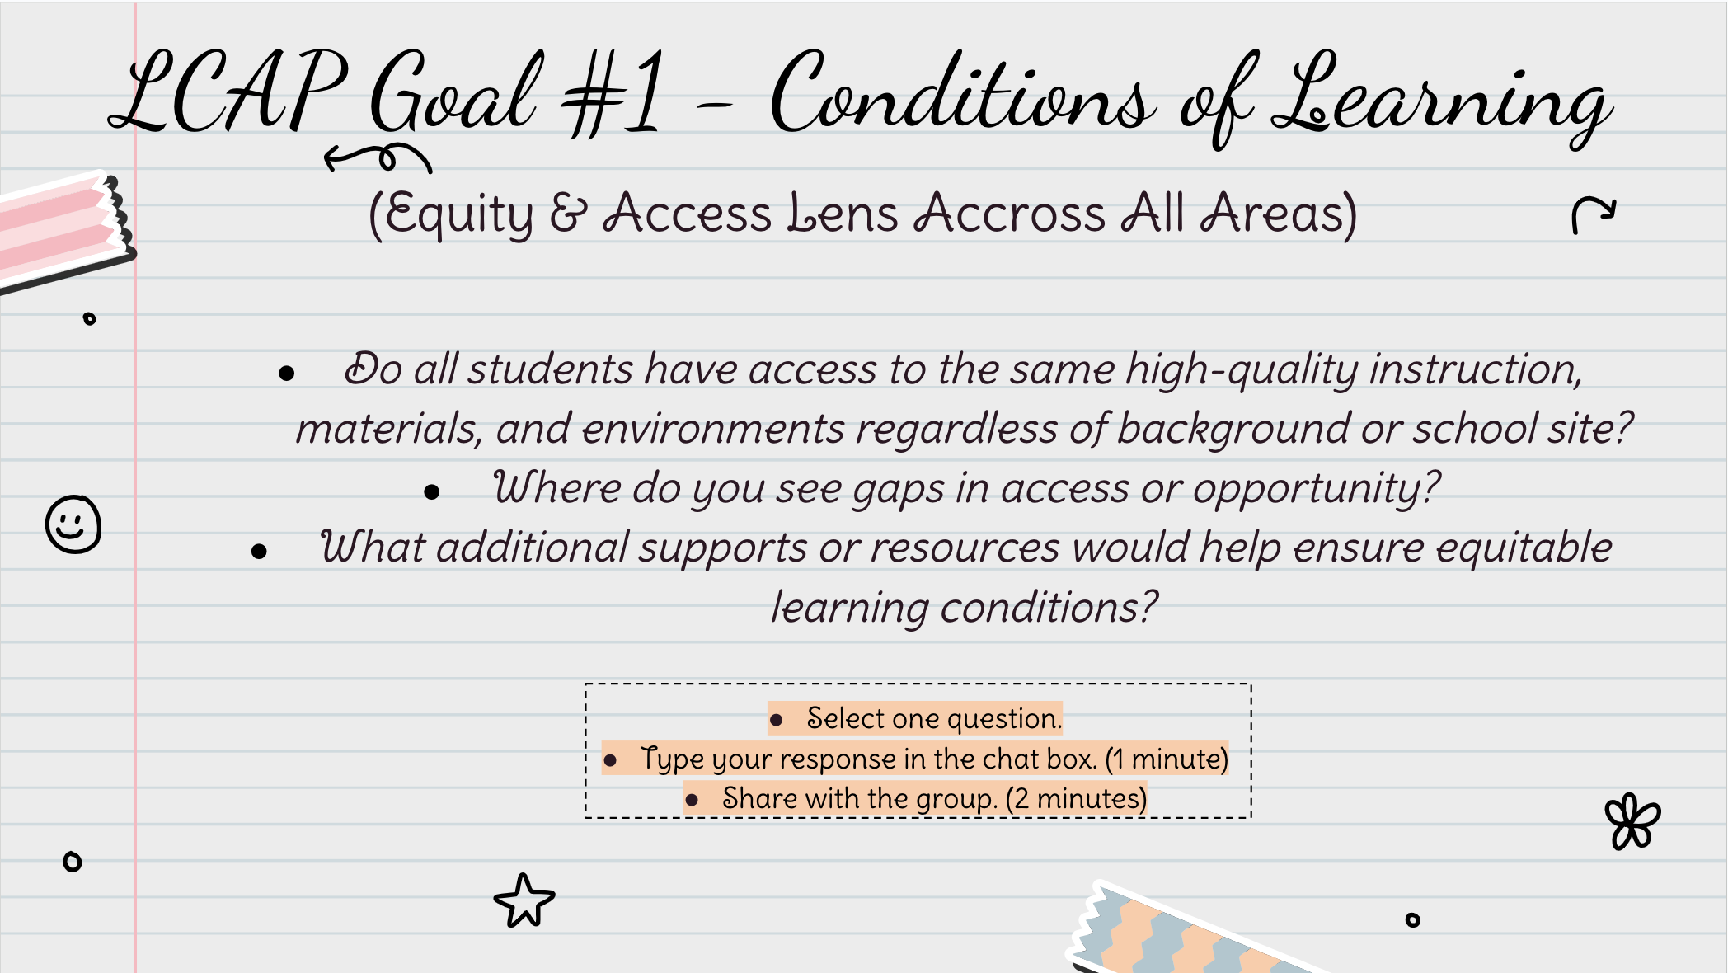

Slide 24
LCAP Goal #1
Goal
Partner Input
What additional ideas/suggestions do you have to improve students outcomes aligned to Goal #1?
Actions/Services
Ensure all students have access to equitable conditions of learning by providing and investing in highly qualified staff, well-maintained facilities and equipment, as well as robust standards-aligned instructional materials and resources. (Conditions of Learning)
Standards-aligned curriculum and materials
Technology & tech support
Physical Safety (building maintenance, HR training, janitorial, etc.)
Teacher induction program
Use this place to put your notes
Click here to access the school’s 25/26 LCAP.

Slide 25
LCAP Goal #2
Goal
Actions/Services
Partner Input
What additional ideas/suggestions do you have to improve students outcomes aligned to Goal #2?
Provide high-quality, equitable, and responsive instruction so that ALL students can reach their full academic potential and be well-prepared to post-secondary experiences.
Professional Development
NWEA MAP Assessment
Intervention Staff & Programming
ELA & Math Tutoring
Specialized staff and programs (SPED, EL, etc.)
High School Counsellors
College and Career Programs
Use this place to put your notes
Click here to access the school’s 25/26 LCAP.

Slide 26
LCAP Goal #3
Goal
Actions/Services
Partner Input
What additional ideas/suggestions do you have to improve students outcomes aligned to Goal #3?
Foster a welcoming and inclusive environment for all students, staff, parents, families and educational partners in support of all students' success in school.
Leader in Me
Holistic Student Assessment
SEL Support Staff
Online Safety (Securly)
Arts & Music Programming
Field Trips
Family Events
Communication Platforms
School Marketing
Use this place to put your notes
Click here to access the school’s 25/26 LCAP.

Slide 27
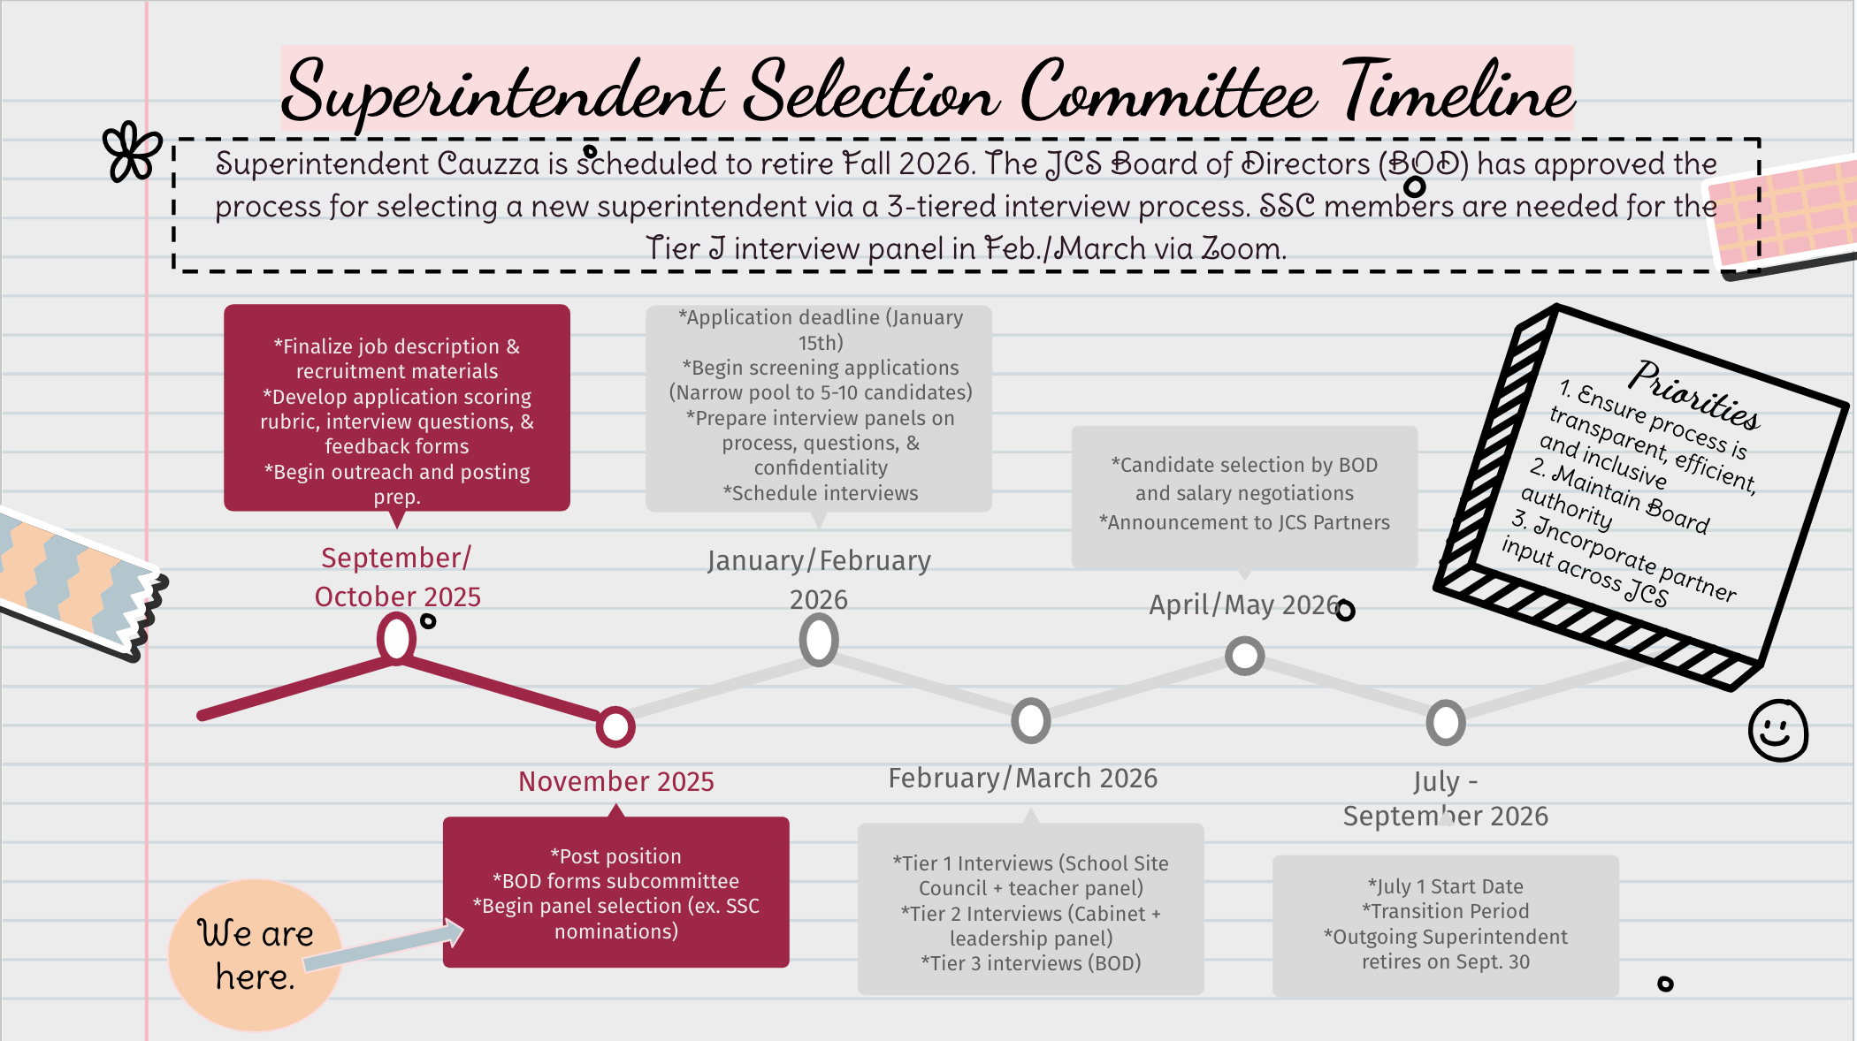

Slide 28
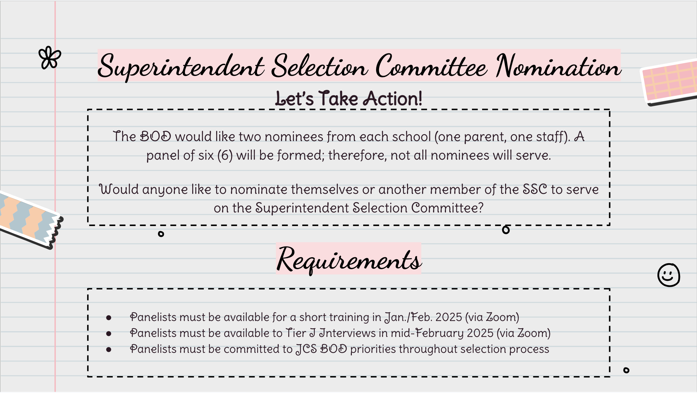

Slide 29
Comprehensive Safety Plan
Partner Input
Note - CSPs being updated in Document Tracking Services (DTS) to follow a uniform template.
The CSP is a school resource for preparedness, prevention, mitigation, response and recovery planning and training.
The CSP is a requirement of the annual Safety Plan Process under SB 187 and the National Incident Management System.
The CSP is updated and approved annually by the School Safety Committee by March 1st for the following school year.
The School Safety Committee may complete the Facility Inspection Tool (FIT).
Are there any safety hazards you see in your workplace/school space?
Do you have any health and safety concerns which need to be addressed by the school?

Slide 30
25/26 Arts & Music (Prop 28) Plan
Prop 28 Board Presentation
Prop 28 Expenditure Plan for 2025/2026
Key Details
  Annual Funding (based on enrollment and F&R population)
  Annual funds must be spent within 3 years
  Allowable Expenditures: Instruction, Supplies, Materials, & Partnerships for Arts education Programs (creative arts, Visual Arts, Craft Arts, Folk Arts, Graphic Arts, etc.)
  25/26 Apportionment: $36,724
  25/26 Planned Expenditures: weekly music lessons with a vendor (Center for World Music), music concerts (field trips) and assemblies, and visual arts lessons and supplies.
  Do you have any additional suggestions for Prop 28 funding?

Slide 31
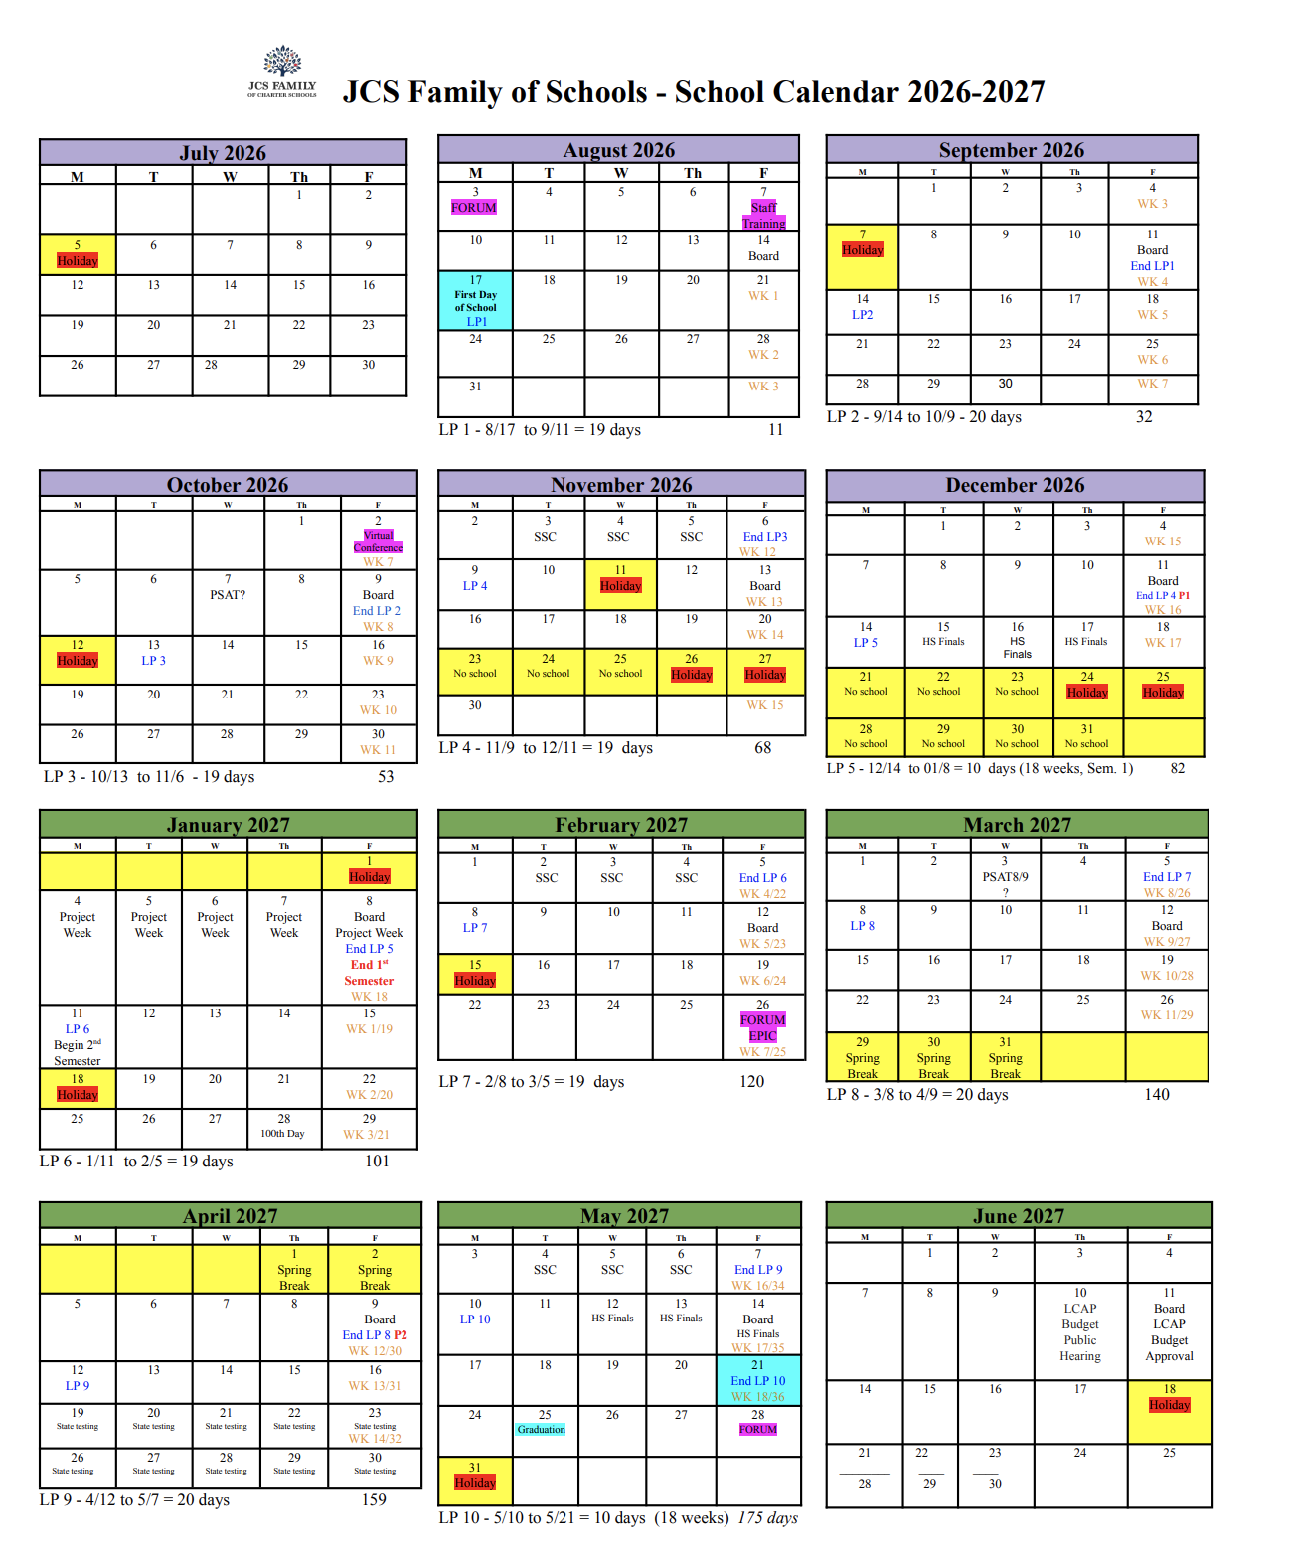
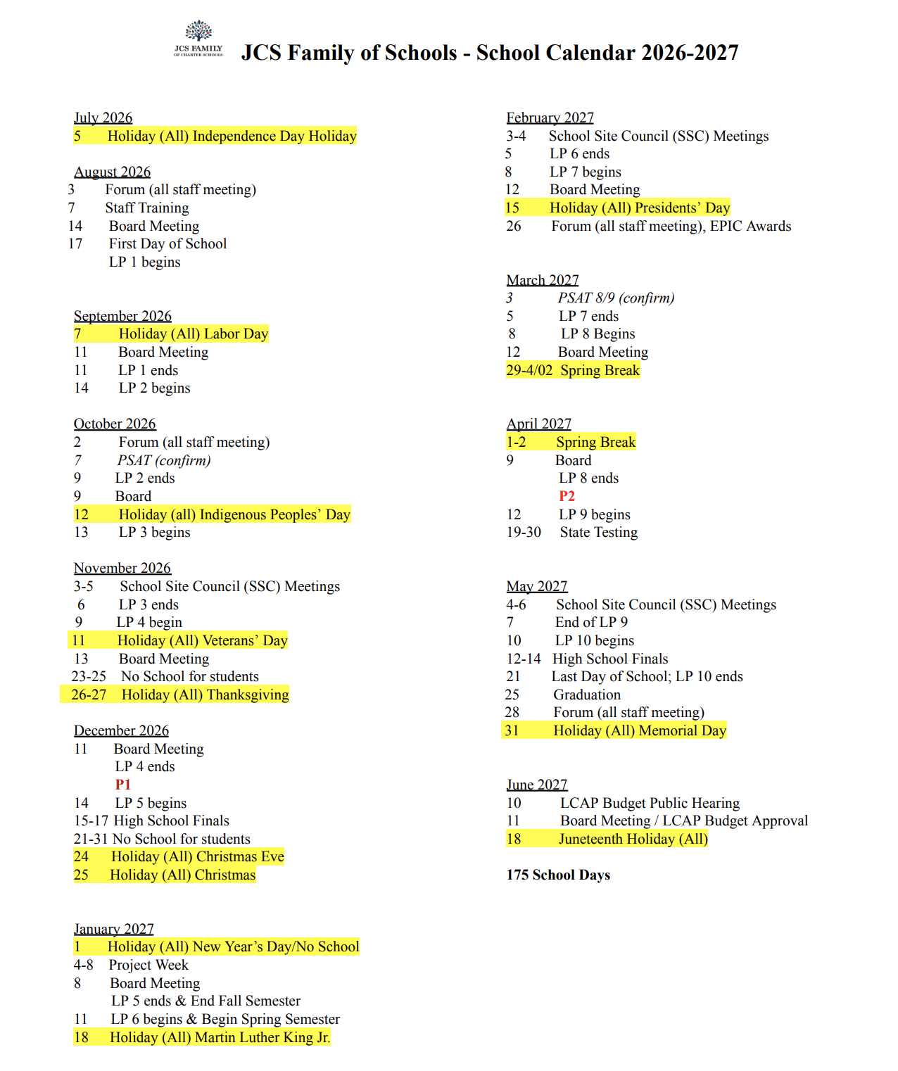
26/27 Calendar Review & Input

Slide 32
Roundtable Discussion
Is there anything else you would like to discuss?
Are there specific topics you would like to see on the next agenda?

Slide 33
Thanks!
Do you have any questions?
Sheryl McKay, Principal
smckay@jcs-inc.org
Jennifer Cauzza, JCS Superintendent
jcauzza@jcs-inc.org
Hillary Gaddis, JCS Accountability Coordinator
hgaddis@jcs-inc.org
Please keep this slide for attribution

