Slide 1

School Site Council
JCS-Manzanita
February 4, 2026

Slide 2

“We are stronger when we listen, and smarter when we share.”
-Rania Al-Abdullah,
The Queen of Jordan

Slide 3

Agenda
Opening Items
Welcome/Introductions
Agenda Preview
Comments Regarding Items NOT on the Agenda
Discussion Items
Budget/Enrollment Overview
Board Reports & School Update
Student/School Performance Data
School Improvement Input & Collaboration (LCAP)
Comprehensive Safety Plan
26/27 School Calendar
Charter Renewal
Roundtable Discussion

Slide 4
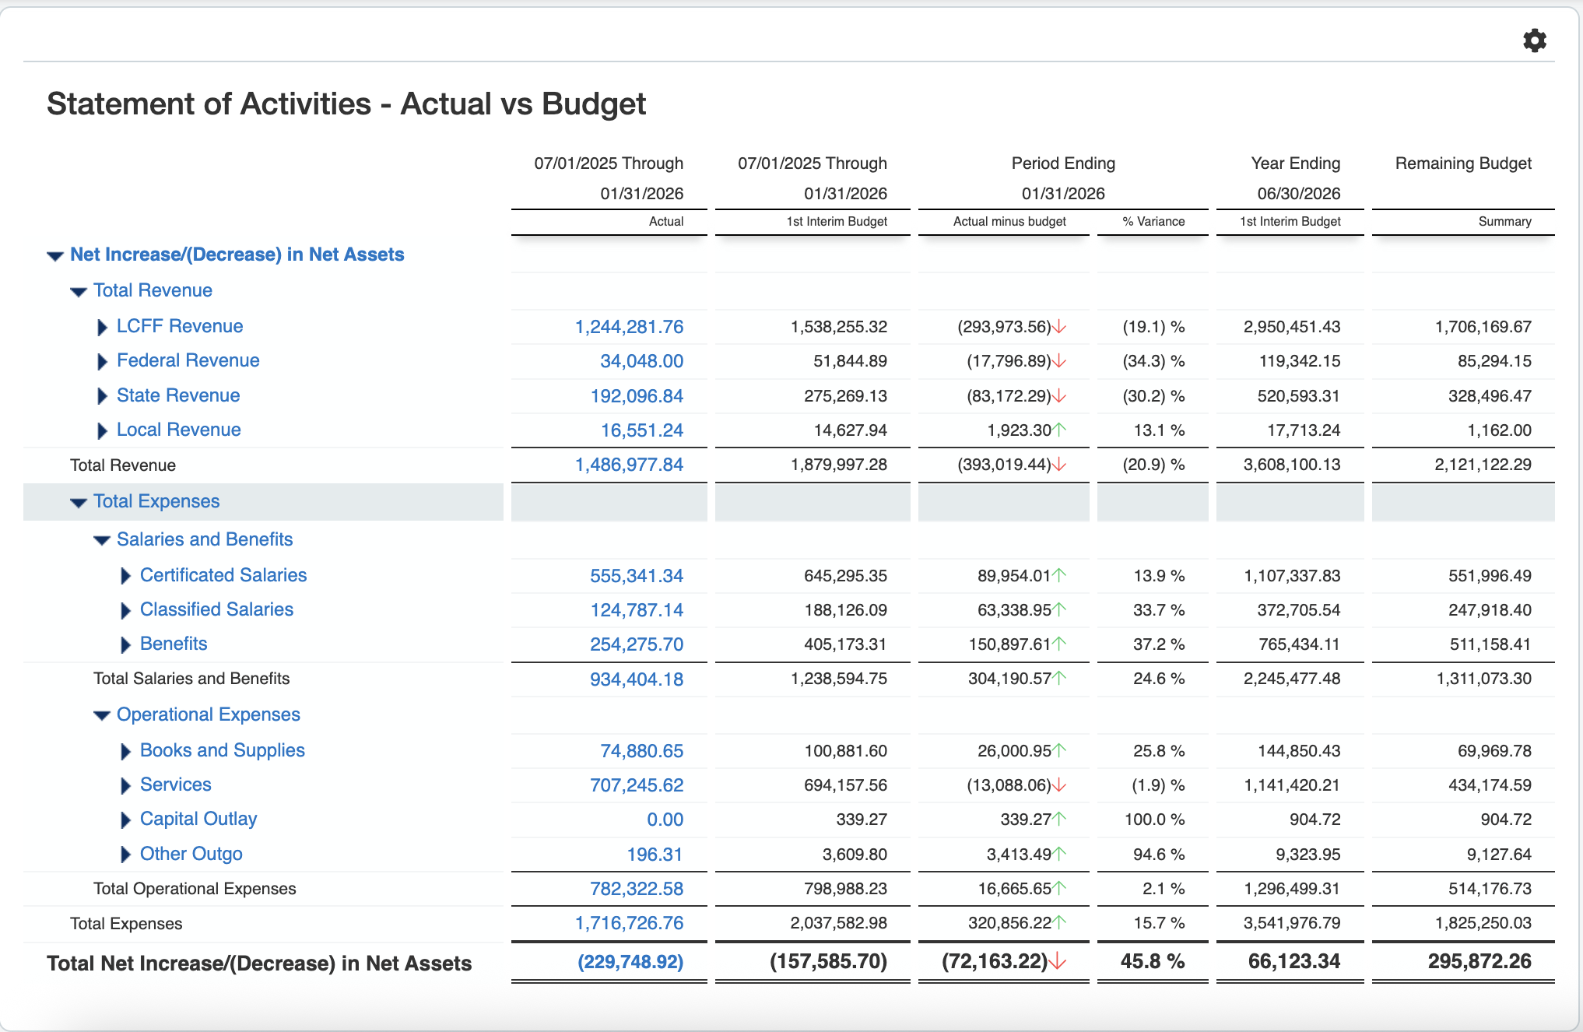
YTD Budget to Actuals

Slide 5
YTD Budget to Actuals
Account Description | Actual July-Dec | Total Budget 1st Interim | Remaining Budget | % of Remaining Budget
Total Revenue | $1,486,978 | $3,608,100 $3,277,092 | $2,121,122
Certificated Salaries | $555,341 | $1,107,338 $1,109,658 | $551,996 | 50%
Classified Salaries | $124,787 | $372,706 $273,821 | $247,918 | 67%
Employee Benefits | $254,276 | $765,434 $685,401 | $511,158 | 68%
Total Personnel Expenses | $934,404 | $2,245,477 $2,068,880 | $1,311,073 | 58%
Books and Supplies | $74,881 | $144,850 $130,676 | $69,970 | 48%
Services & Operating Expenses | $707,246 | $1,141,420 $1,077,817 | $434,175 | 38%
Total Operational Expenses | $723,323 | $1,296,499 $1,230,601 | $511,158 | 39%
Total Expenses | $1,716,727 | $3,541,977 $3,299,480 | $1,825,250 | 52%

Slide 6
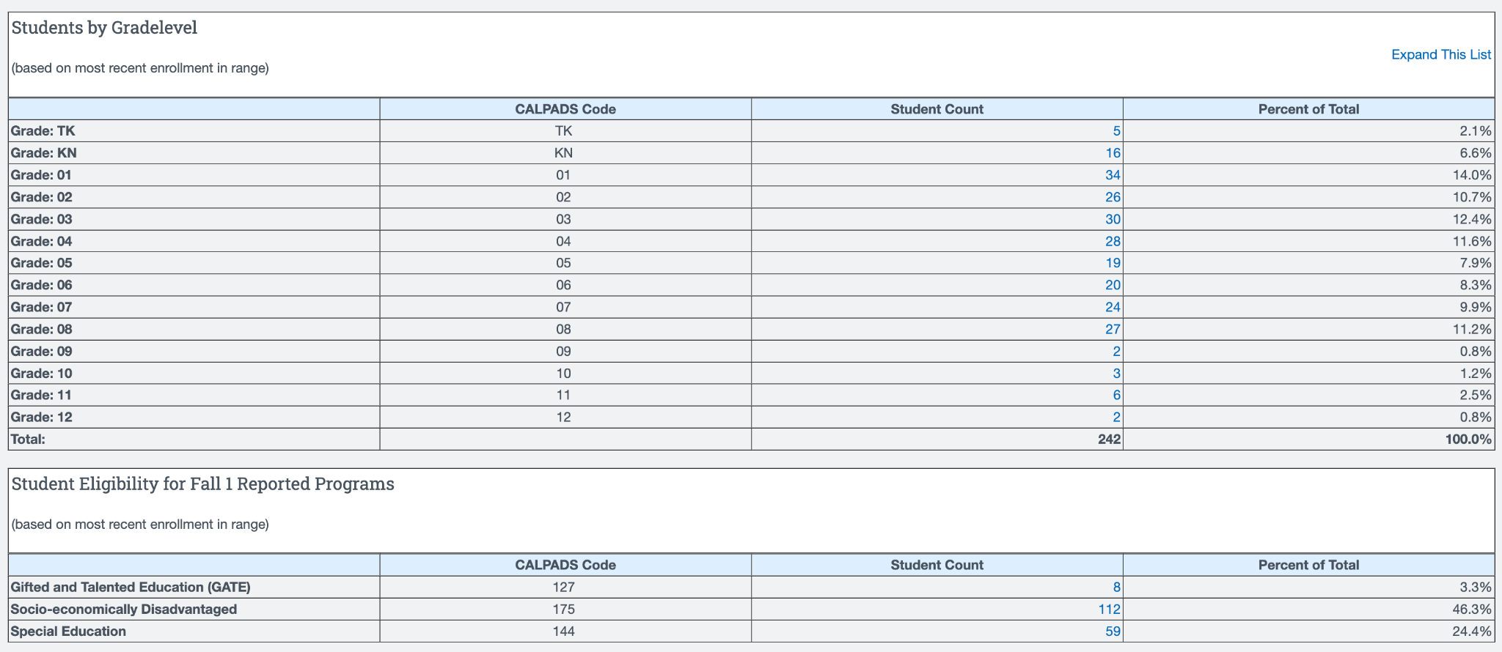
Enrollment (as of February 2, 2026)

Slide 7
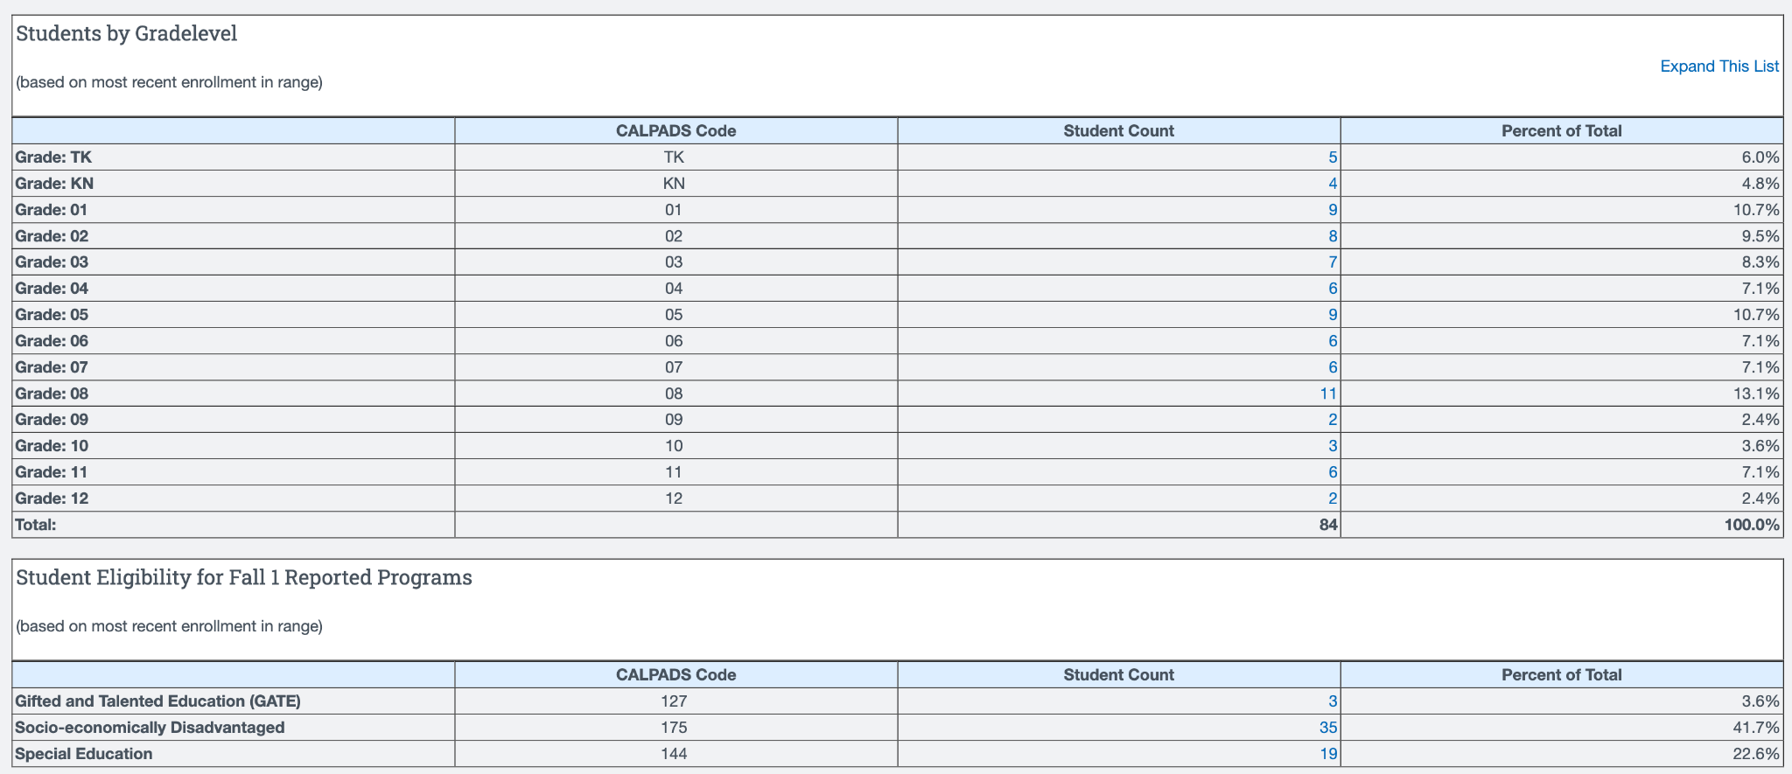
Enrollment (as of February 2, 2026)
Home Study

Slide 8
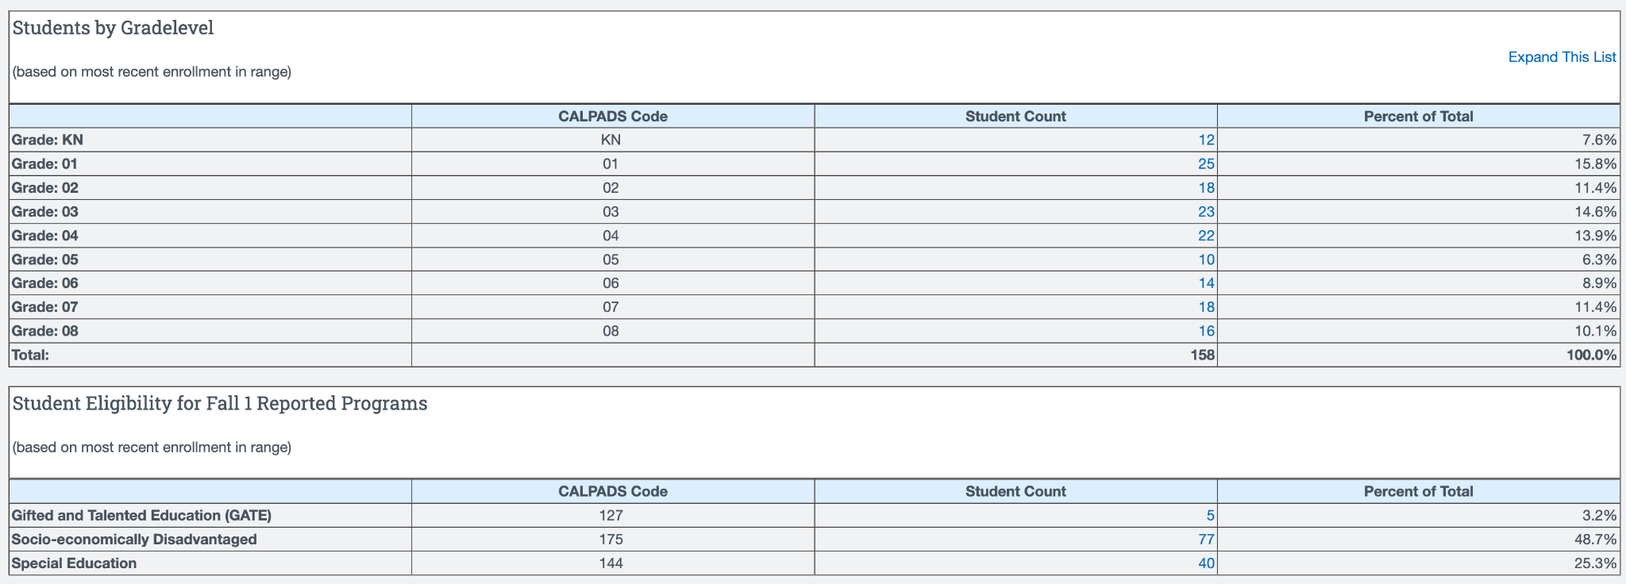
Enrollment (as of February 2, 2026)
Academy

Slide 9

JCS Board Reports
The next meeting of the JCS BOD will be held on Friday, February 13th at the JCS Central Office and via Zoom (access at jcs-inc.org).
November 2025 - no report
December 2025 - no report
January 2026 - no report
Agenda Highlights
School Accountability Report Card (Jan. 2026)
LCAP Mid-Year Review (Jan. 2026)
Longevity Pay Proposal (Jan. 2026)
1st Interim Report (Dec. 2025)
Board Selection for the Superintendent Subcommittee (Nov. 2025)
Lots of Policy Readings and Adoptions!

Slide 10
School News & Highlights
Reading Difficulties Screener for K-2 students (mCLASS w/ DIBELS)
Testing Season is Coming! PFT, CAASPP, ELPAC, etc.
Project Week & EPIC Awards
Leader in Me implementation continues to impact student efficacy
Library at MZE & Center for World Music
Beyond & Friday Field Trips (Fleet Center, Oma’s Pumpkin Patch, Legoland, SD Zoo, Heritage of the Americas,
Academy Field Trips: San Diego Missions, Conservation Lab, 6th grade camp
Kindness Week at MZE
Wellness Coach

Slide 11
Upcoming Highlights
PTO Events (Bingo Night)
Living History Museum at MZE
Biz Town for 5th in May
Friday Field Trips: Maritime Museum, Jump Into Spring Break, Ringer’s Roller Rink
Spirit Days, Manza Mixers, & Elective Block
Parent Teacher Conferences
SDCOE Board president visit in March
SDCOE Annual Visit in May
Not So Highlights
Reduced staff
Enrollment decline
Illnesses & Absences

Slide 12
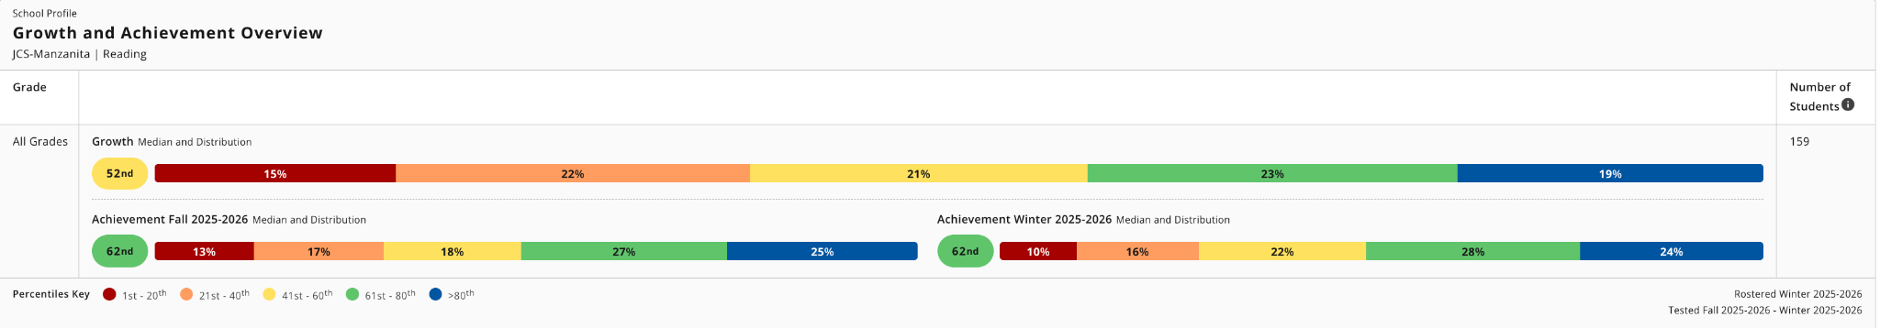
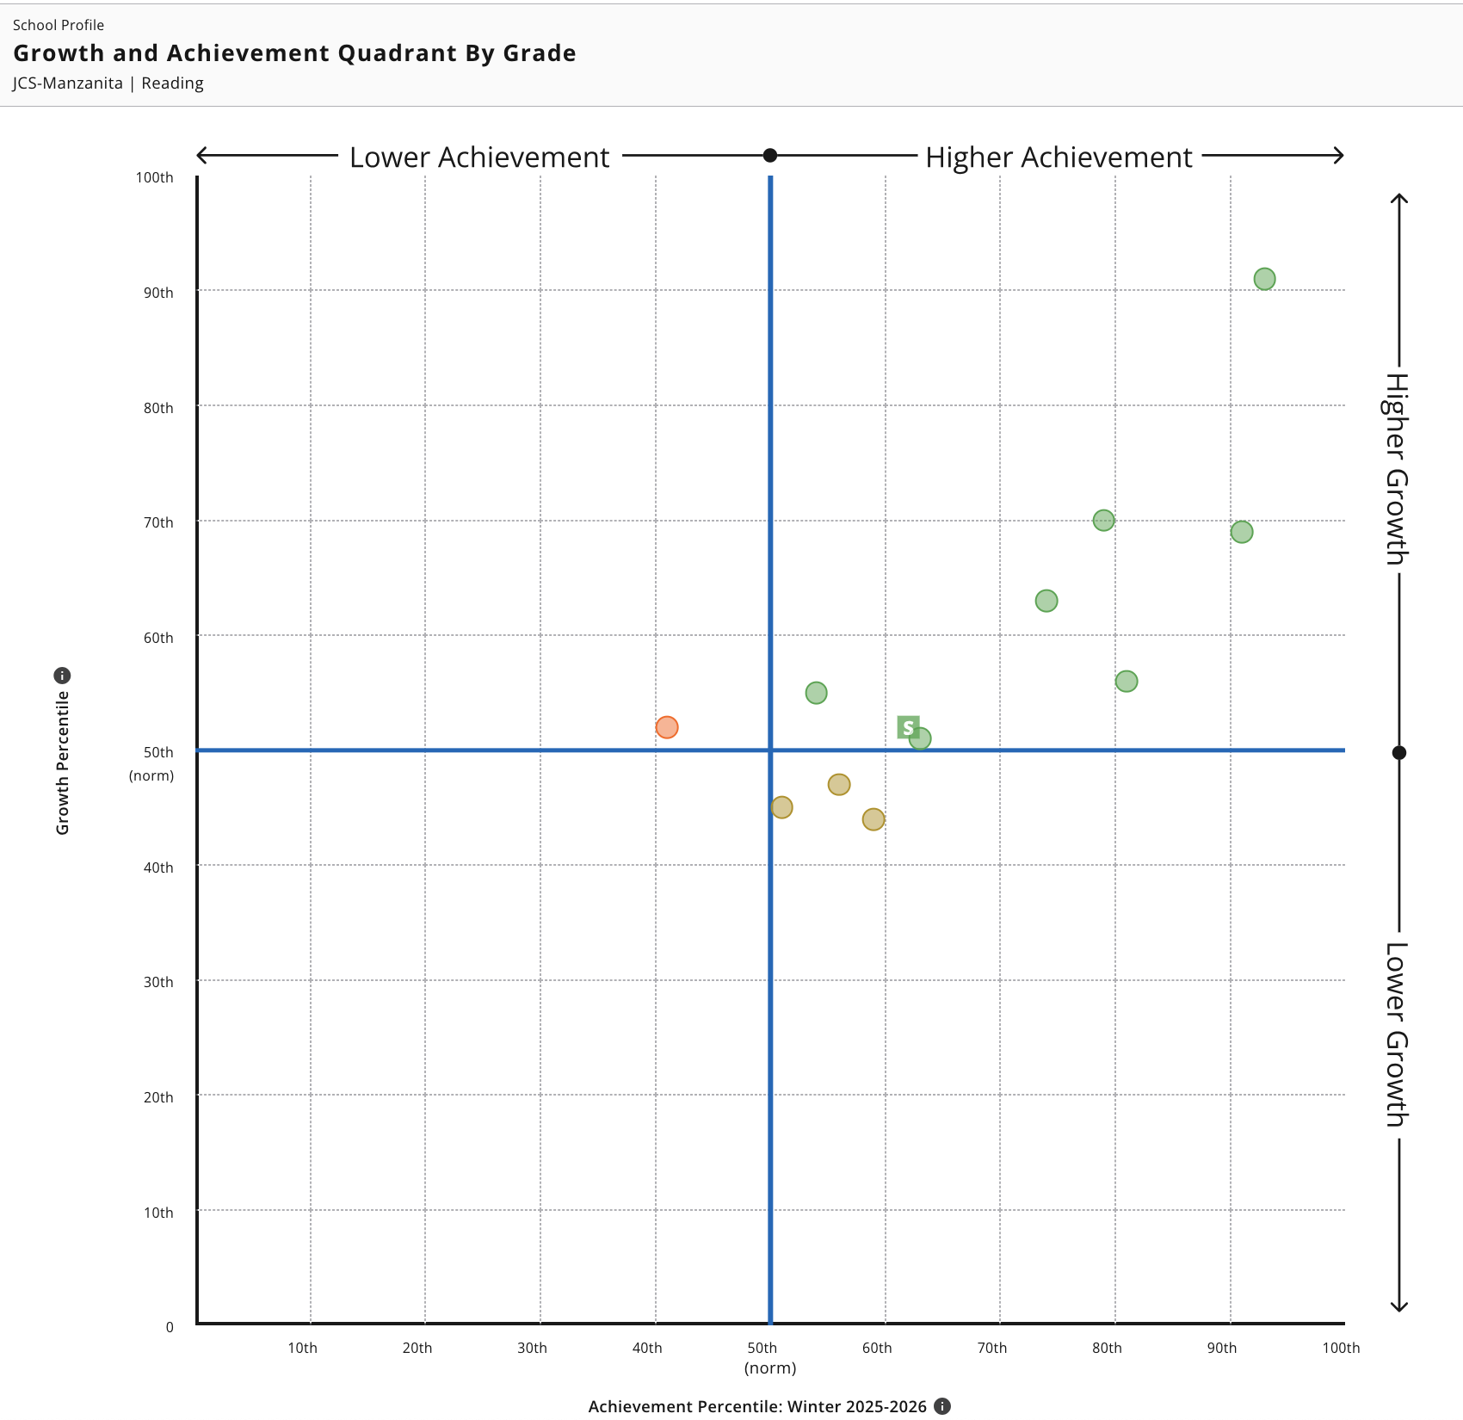
NWEA MAP Fall to Winter Growth (Reading)
Reading growth is slightly above average: Median growth is at the 52nd percentile, with a balanced spread across bands and nearly 42% of students above the 61st percentile.
Achievement remained stable across the year: Median achievement held steady at the 62nd percentile from Fall to Winter, indicating consistent performance without significant gains or losses.
Large cohort supports reliability: With 159 students, results suggest a stable, schoolwide reading program with room to push more students into higher growth bands.
12
11
9
3
6
10
2
4
8
7
5

Slide 13
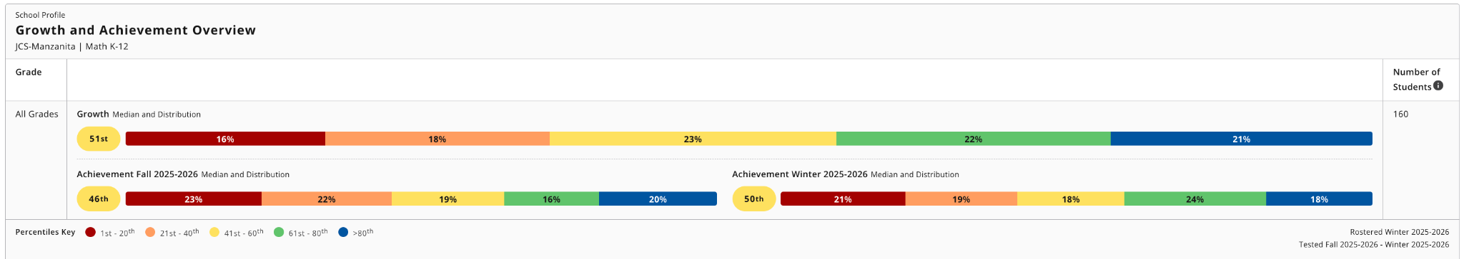
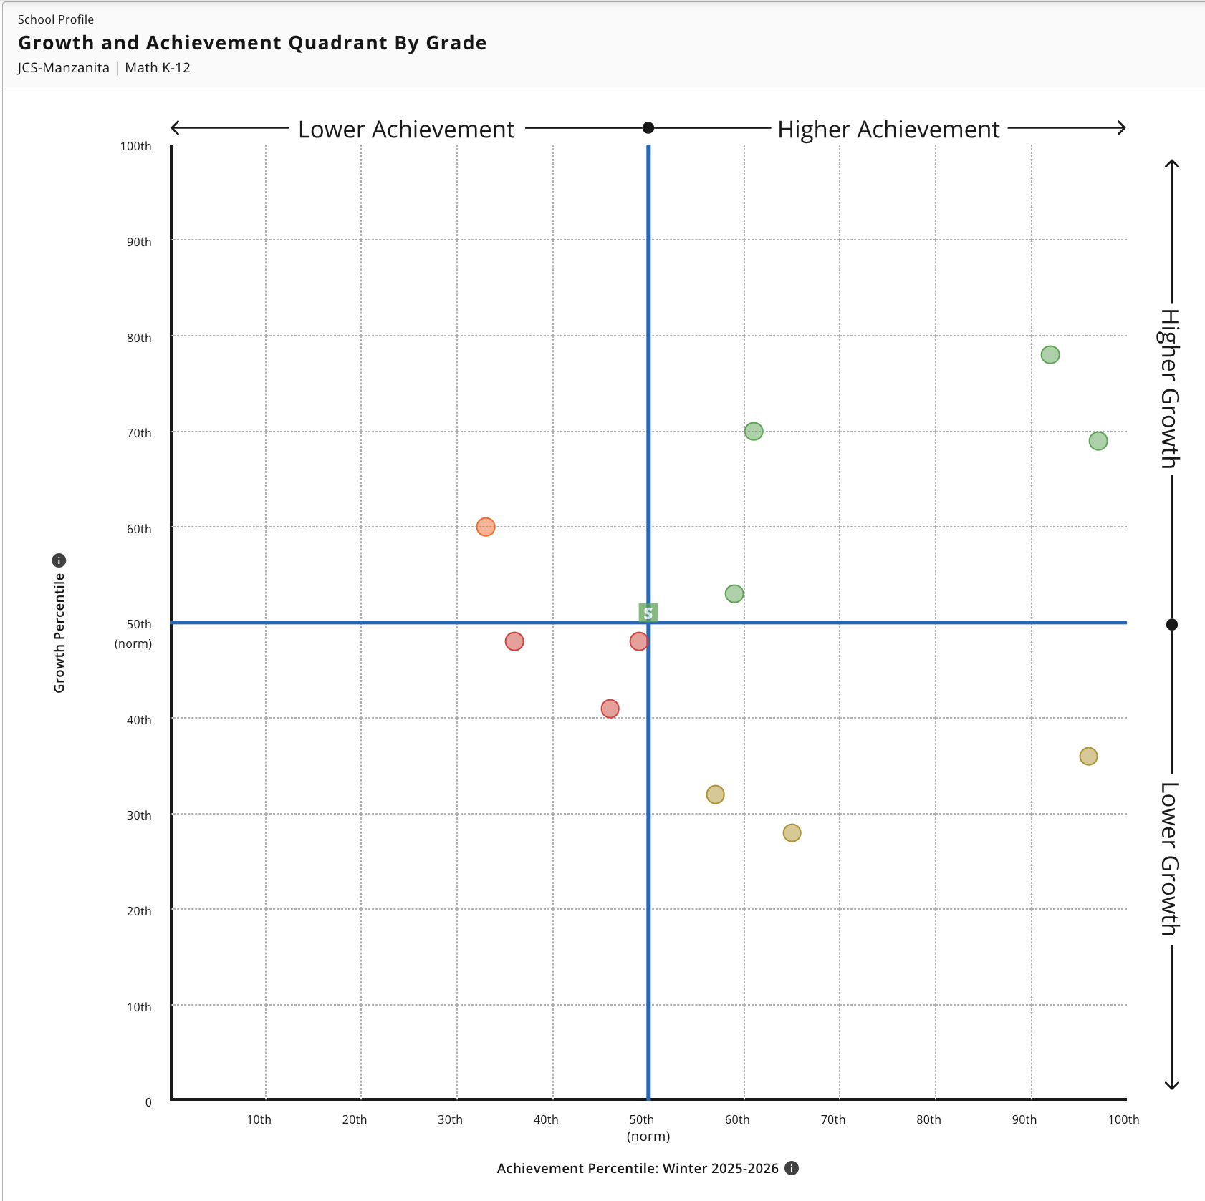
NWEA MAP Fall to Winter Growth (Math)
Math growth is about average: Median growth is at the 51st percentile, with a fairly even distribution across performance bands, indicating typical progress overall.
Achievement improved modestly: Median achievement increased from the 46th percentile (Fall) to the 50th percentile (Winter), suggesting slight gains in overall proficiency.
Large sample shows mixed performance: With 160 students, results point to steady but uneven achievement, with roughly equal proportions of students below and above the 50th percentile.
9
3
12
8
7
6
4
5
2
11
10

Slide 14
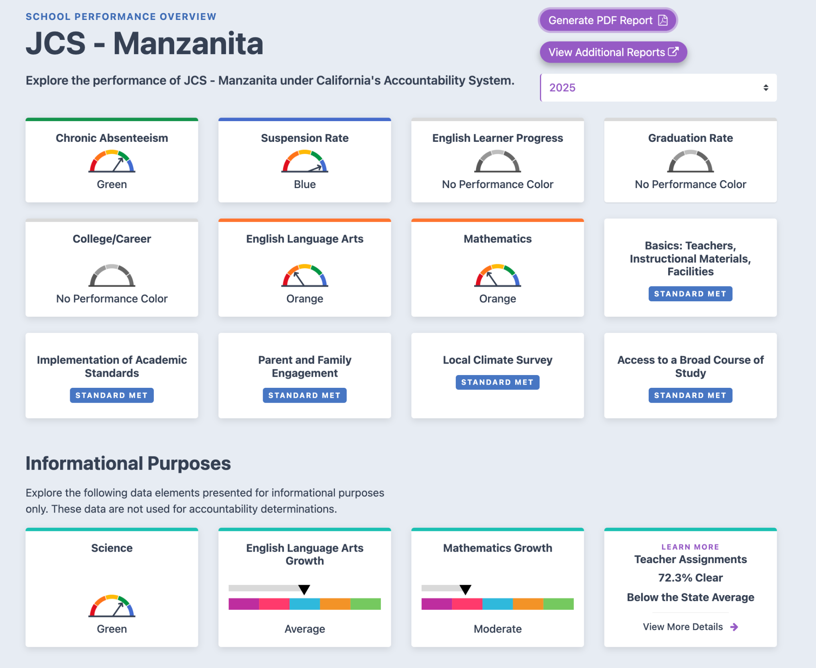
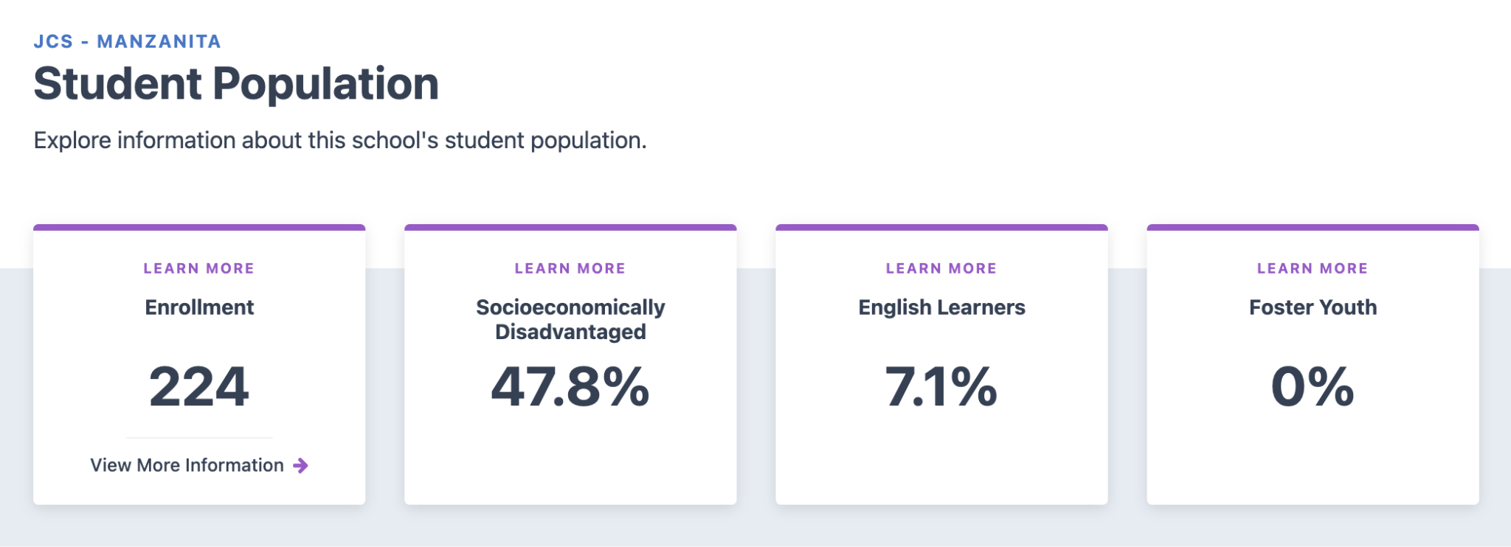
2025 CA School Dashboard
Link to 2025 Dashboard Report for JCS-MZ.
Based on the 2024 & 2025 CA School Dashboards, JCS-Manzanita is a “Middle” Performing charter school. Charter renewal evaluation for Middle Performing charter schools is based on verified data and the schools ability to show students achieving a year of growth each year. Middle Performing charter schools may be renewed for a 5-year term.

Slide 15
Local Control and Accountability Plan
Goal #2 - Student Outcomes
Provide high quality, equitable, and responsive instruction so that ALL students can reach their full academic potential and be well-prepared for postsecondary experiences.
Click here to access the School’s 25/26 LCAP.

Slide 16
LCAP Goal #2 - Partner Input
Instructional Quality
For Parents:
Do you feel your child’s teachers use effective strategies to help them learn?
How well does the school communicate about your child’s academic progress and learning needs?
For Students:
Do your teachers explain lessons in ways that help you understand?
Are class activities engaging and challenging enough to help you grow academically?
How often do you receive helpful feedback on your work?
For Staff:
How confident are you that your instruction meets the diverse academic and cultural needs of your students?
How often do you use data (formative, summative, or behavioral) to adjust instruction?

Slide 17
LCAP Goal #2 - Partner Input
Equity and Responsiveness
For Parents:
Do you believe the school provides equitable learning opportunities for all students?
How well does the school respond to your child’s individual academic or social-emotional needs?
For Students:
Do you feel your teachers respect and value your background, culture, and learning style?
When you need extra help, do you get the support you need to succeed?
For Staff:
How effectively do you differentiate instruction for students with varying learning needs, backgrounds, and abilities?
Do you feel supported in implementing culturally responsive teaching practices?
Are interventions and supports equitably available to students who need them most?

Slide 18
LCAP Goal #2 - Partner Input
Preparation for Postsecondary Experiences
For Parents:
How confident are you that your child is being prepared for success after high school?
Does the school provide information and guidance on post-secondary options and pathways?
For Students:
Do your classes help you feel prepared for what you want to do after high school (college, work, training, etc.)?
Are you learning skills that will help you succeed in the future (e.g., problem-solving, collaboration, time management)?
Have teachers or counselors talked with you about your post-secondary goals and how to reach them?
For Staff:
Are students given opportunities to apply learning through real-world, project-based, or interdisciplinary experiences?
How prepared do you believe your students are for post-secondary education or career pathways?

Slide 19
Comprehensive School Safety Plan
Annual Review, Update, and Approval by School Safety Committee by March 1, 2026 for 2026/2027 School Year.
School resource for preparedness, prevention, mitigation, response and recovery planning and training.
Requirements of the annual Safety Plan Process under SB 187 and the National Incident Management System.
Link to Public-Facing 25/26 CSSP (Draft) w/ Signature Page
Highlights/New Requirements
  Transferred from Google Docs to Document Tracking Services (DTS) to support JCS alignment and organization.
  NEW--Volunteers added to required Mandated Reporter Training (AB 1913)
  NEW--Emergency Procedure Accommodations for Students with Disabilities
  NEW--Procedures for Immigration Officials on School Campuses (SB 98)
  NEW--Trevor Project Hotline (LGBTQ+ Crisis Number) added to Student IDs (Grades 7-12)
  NEW--Procedures for Student Smartphone Use during Emergencies
  NEW--Emergency Operations Plan: Student Demonstration/Walkout
Are there any safety hazards you see in your workplace/school space?
Do you have any health and safety concerns which need to be addressed by the school?

Slide 20
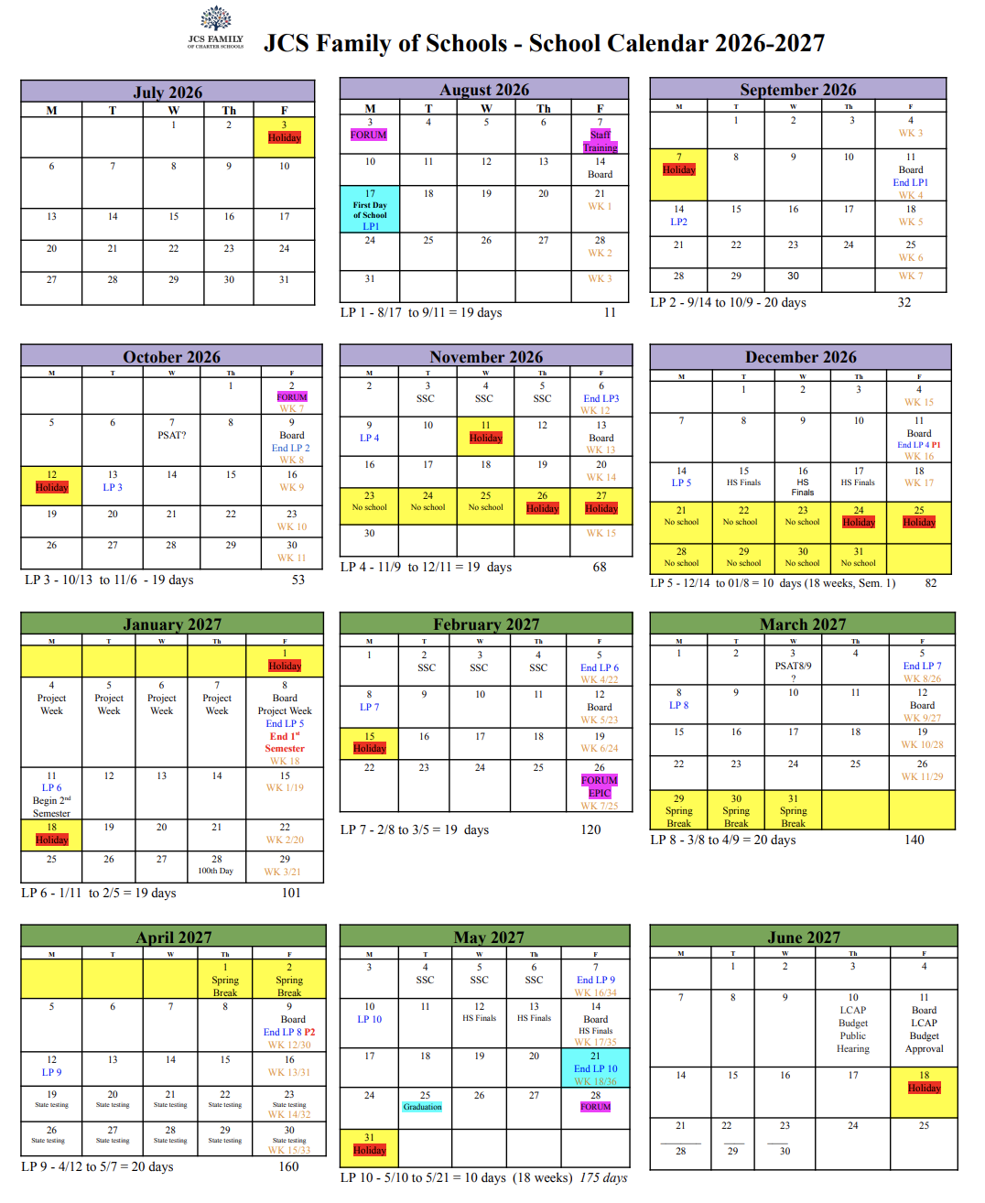
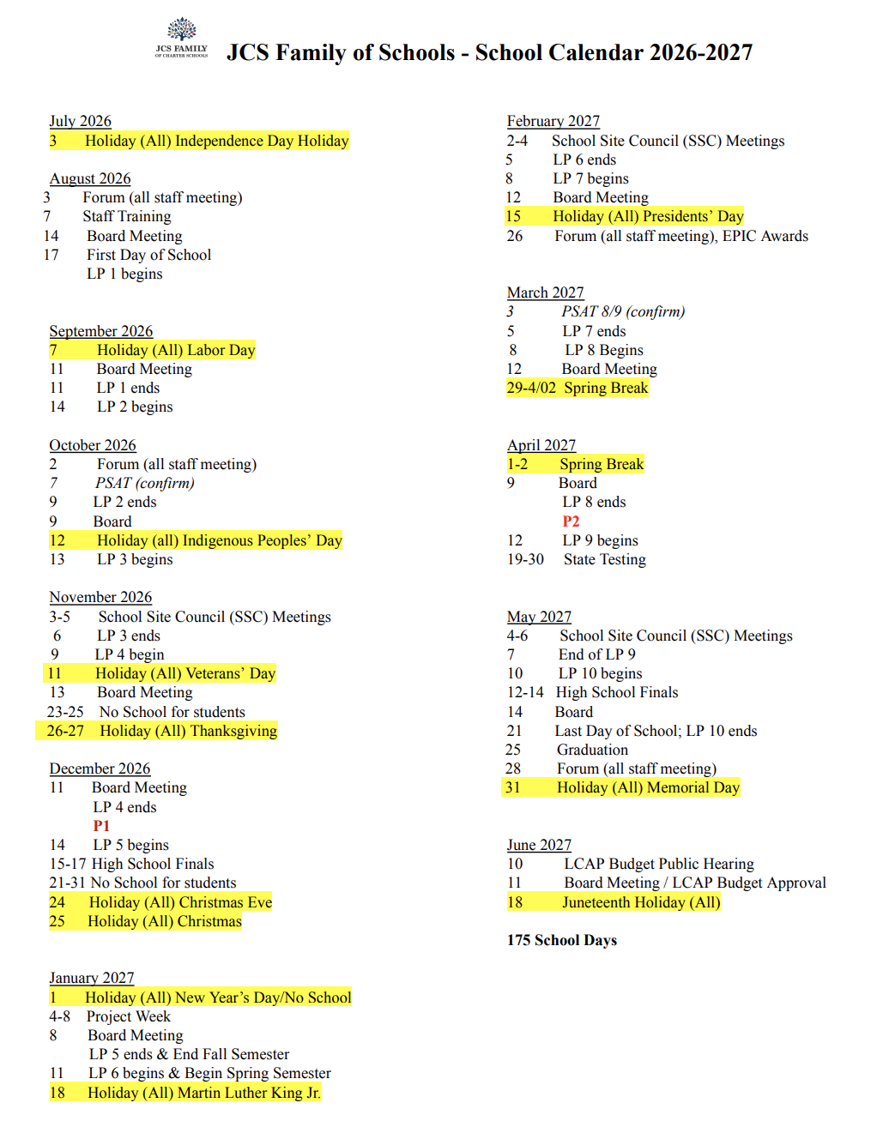
2026/2027 School Calendar

Slide 21
Charter Renewal
Renewal Petition scheduled for submission to SDCBOE by August 3, 2026
Public Hearing in September 2026
Renewal Vote in October 2026
JCS-Manzanita hopes to petition for renewal as a Middle Performing charter school and for a 5-year team (2027-3032)

Slide 22
Roundtable Discussion
Is there anything else you would like to discuss?
Are there specific topics you would like to see on the next agenda?

Slide 23
Thank you!
Questions?
Sheryl McKay, Principal
smckay@jcs-inc.org
Jennifer Cauzza, Superintendent
jcauzza@jcs-inc.org
Hillary Gaddis, JCS Accountability Coordinator
hgaddis@jcs-inc.org

