Slide 1

School Site Council
JCS-Pine Hills
February 2026

Slide 2

“We are stronger when we listen, and smarter when we share.”
-Rania Al-Abdullah,
The Queen of Jordan

Slide 3

Agenda
Opening Items
Welcome/Introductions
Agenda Preview
Comments Regarding Items NOT on the Agenda
Discussion Items
Budget/Enrollment Overview
Board Reports & School Update
Student/School Performance Data
School Improvement Input & Collaboration (LCAP)
Comprehensive Safety Plan
26/27 School Calendar
Charter Renewal
Roundtable Discussion

Slide 4
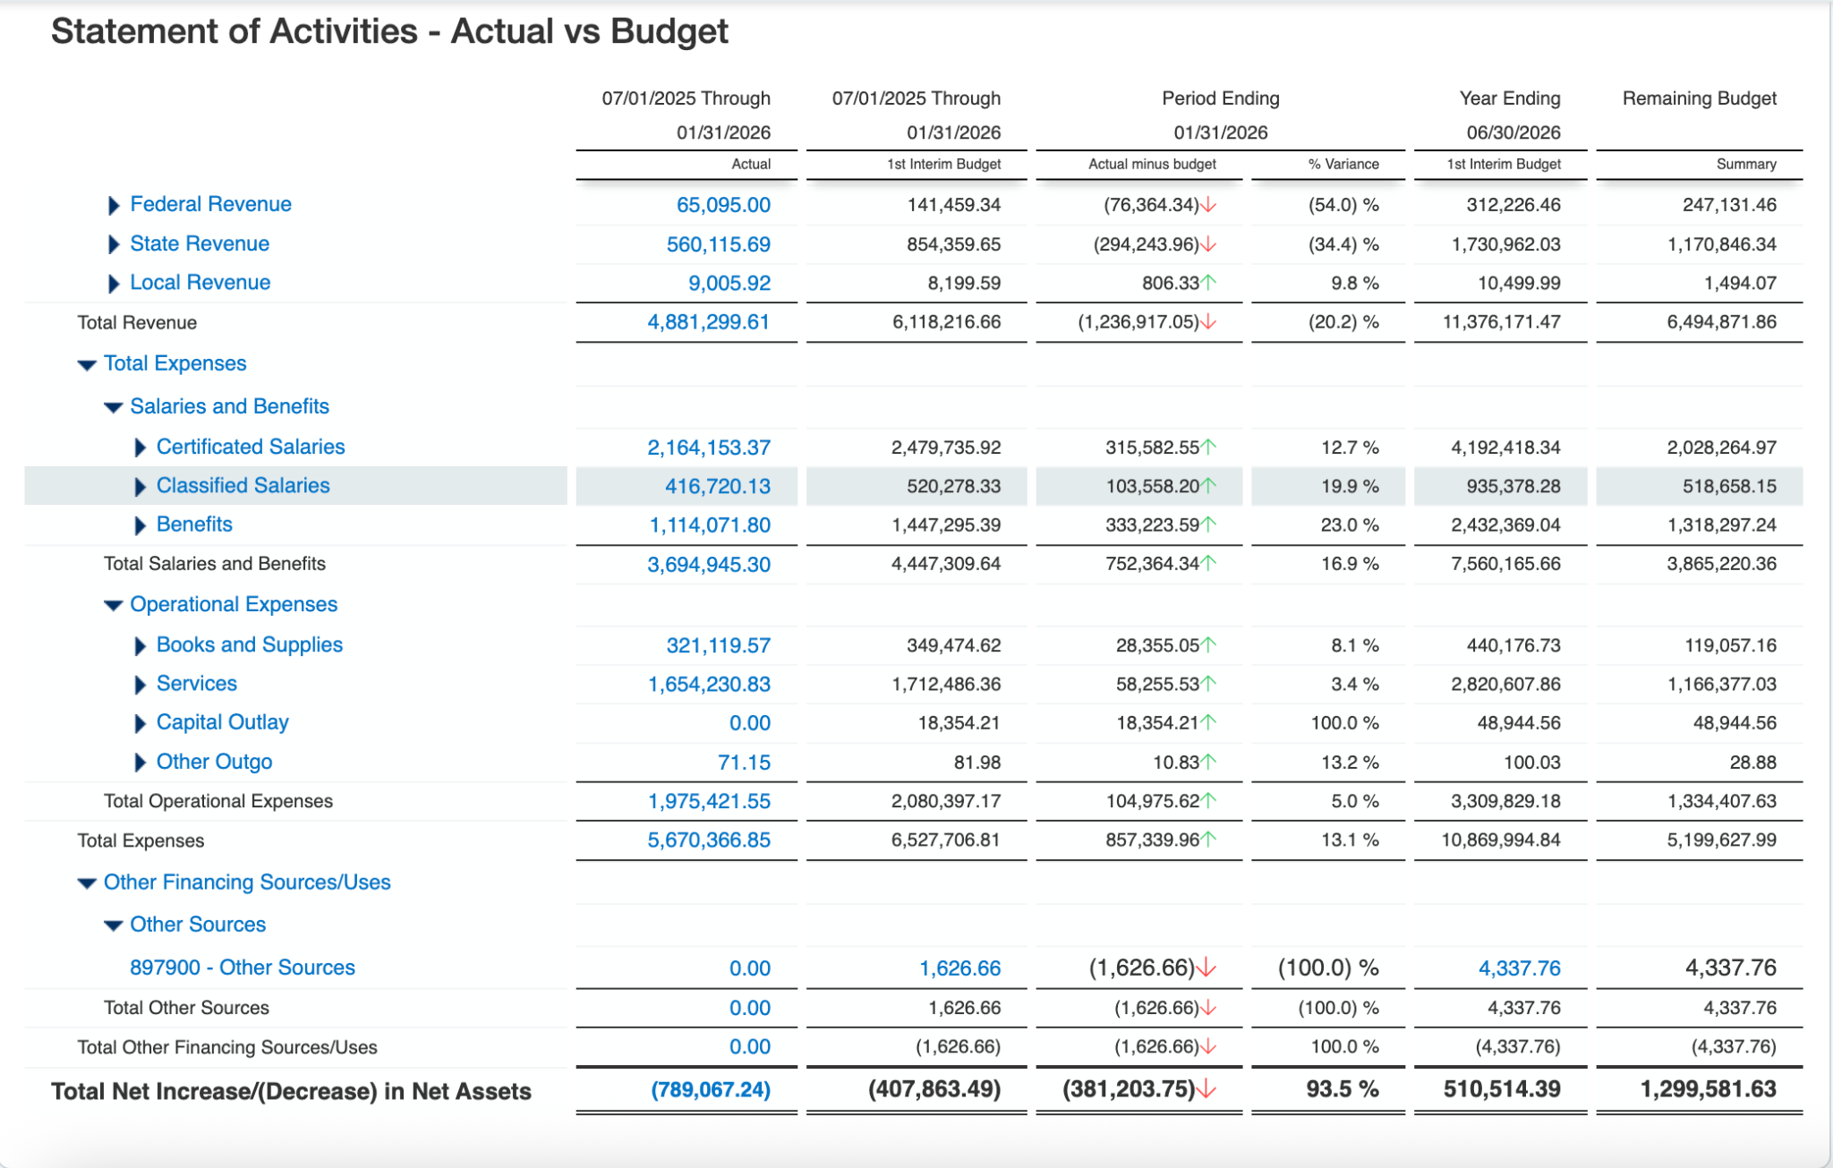
YTD Budget to Actuals
Notes:
2025 - 7

Slide 5
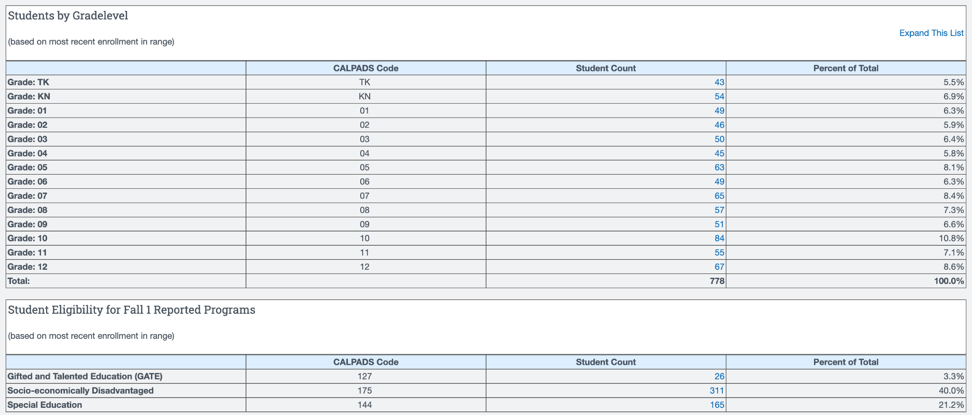
Enrollment (as of February 2, 2026)
Notes:
2025-745 students

Slide 6
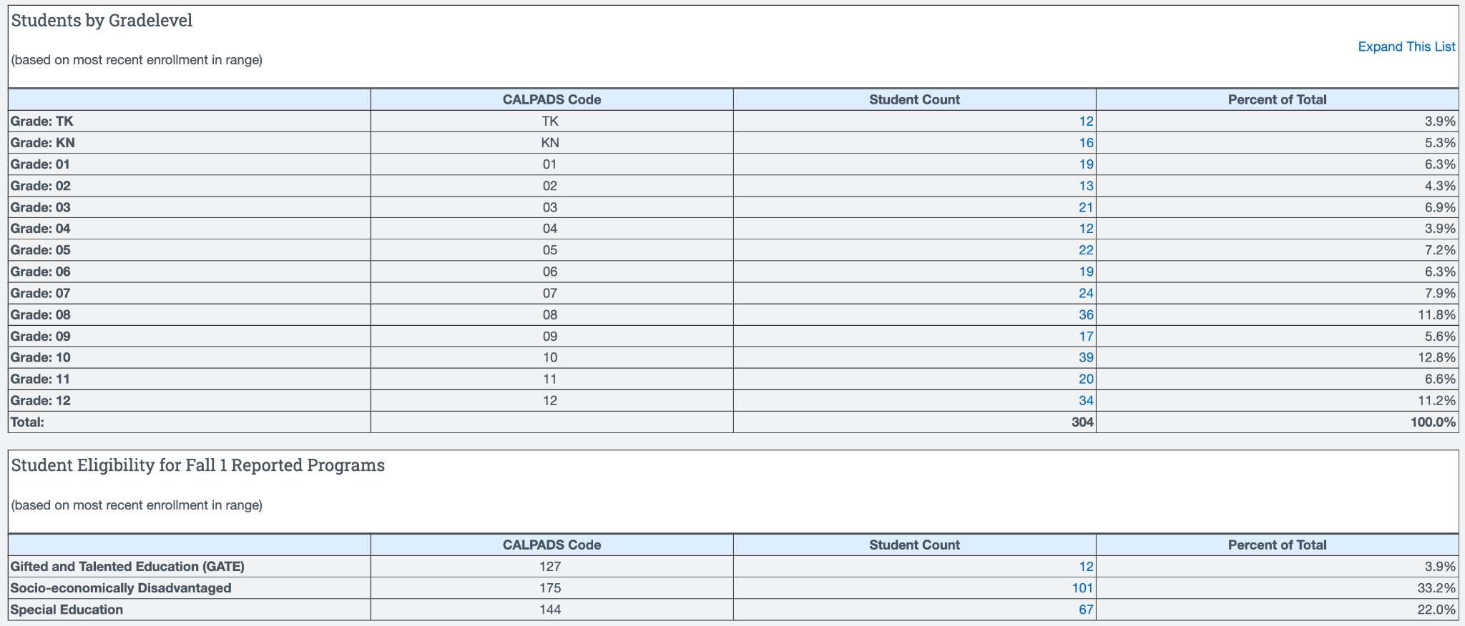
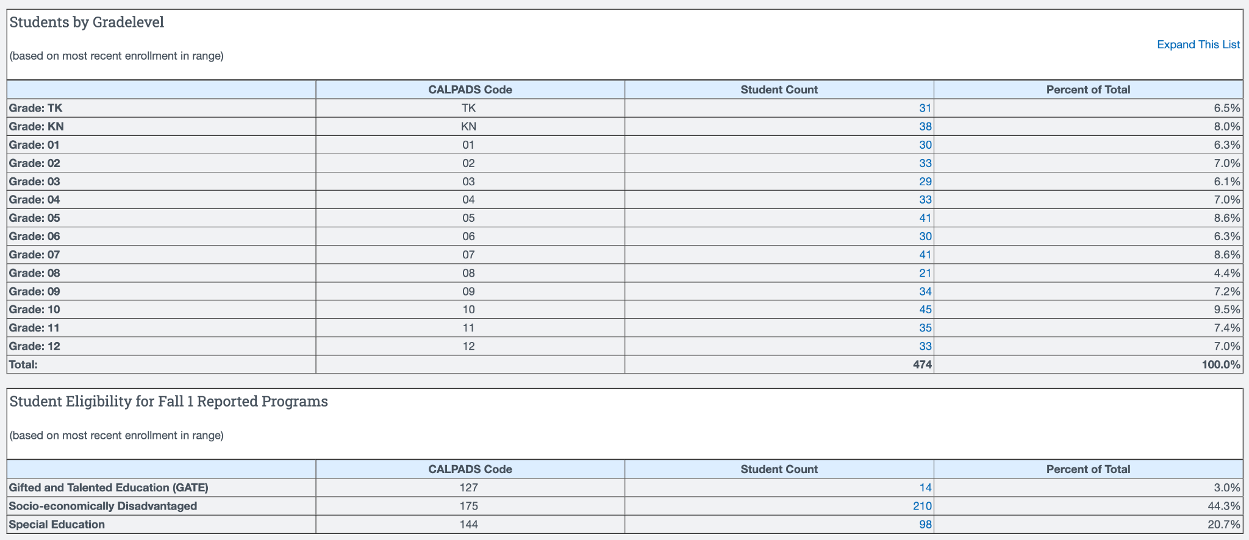
Enrollment (as of February 2, 2026)
Academy
Home Study
Notes:
2025 - academy- 278, home study-467

Slide 7

JCS Board Reports
The next meeting of the JCS BOD will be held on Friday, February 13th at the JCS Central Office and via Zoom (access at jcs-inc.org).
November 2025
December 2025
January 2026
Agenda Highlights
School Accountability Report Card (Jan. 2026)
LCAP Mid-Year Review (Jan. 2026)
Longevity Pay Increase (Jan. 2026)
1st Interim Report (Dec. 2025)
Board Selection for the Superintendent Subcommittee (Nov. 2025)
Lots of Policy Readings and Adoptions!

Slide 8
School News & Highlights
Reading Difficulties Screener for K-2 students (mCLASS w/ DIBELS)
Testing Season is Coming! PFT, CAASPP, ELPAC, etc.
Project Week & EPIC Awards
Leader in ME implementation continues to impact student efficacy

Slide 9
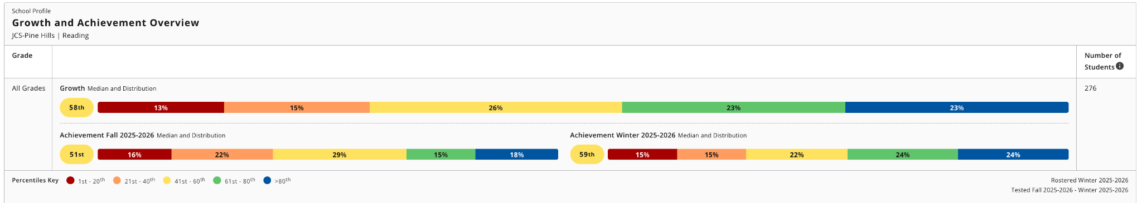
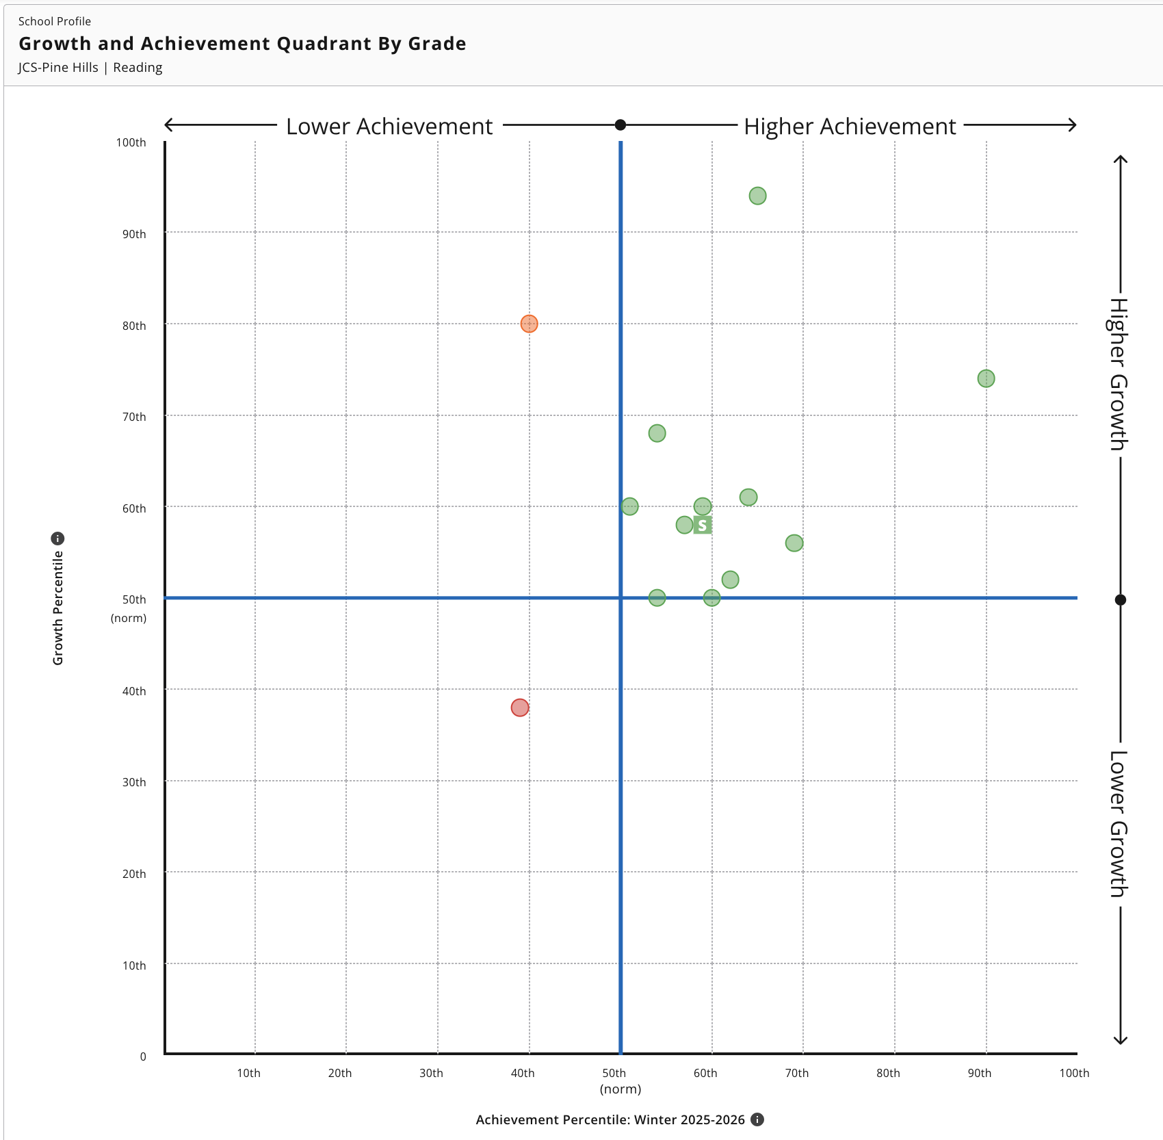
NWEA MAP Fall to Winter Growth (Reading)
Reading growth is above average: Median growth is at the 58th percentile, with nearly 46% of students above the 61st percentile, indicating strong overall progress.
Achievement improved meaningfully from Fall to Winter: Median achievement rose from the 51st percentile (Fall) to the 59th percentile (Winter), with more students moving into higher performance bands.
Large cohort supports confidence in trends: With 276 students, the data reflects a consistent, schoolwide improvement in reading outcomes.
11
12
K
4
10
1
5
9
8
7
6
2
3

Slide 10
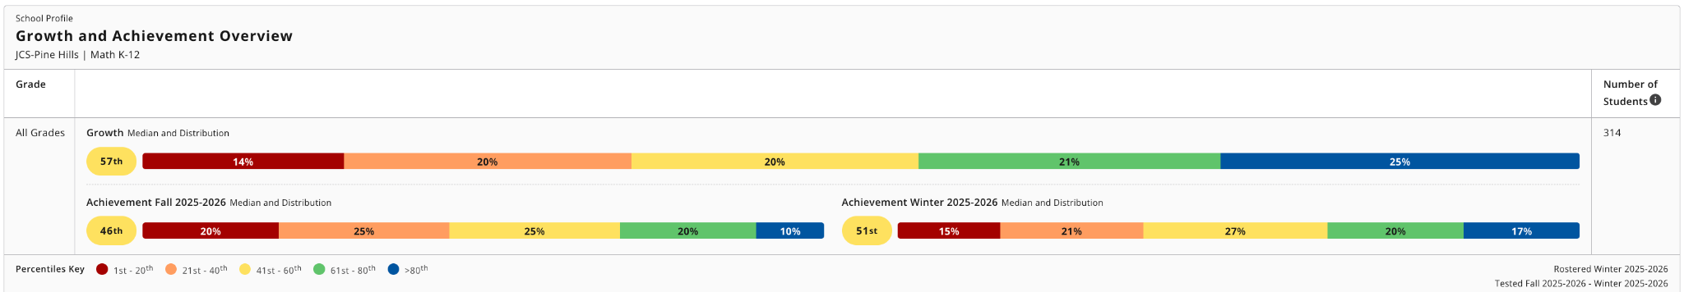
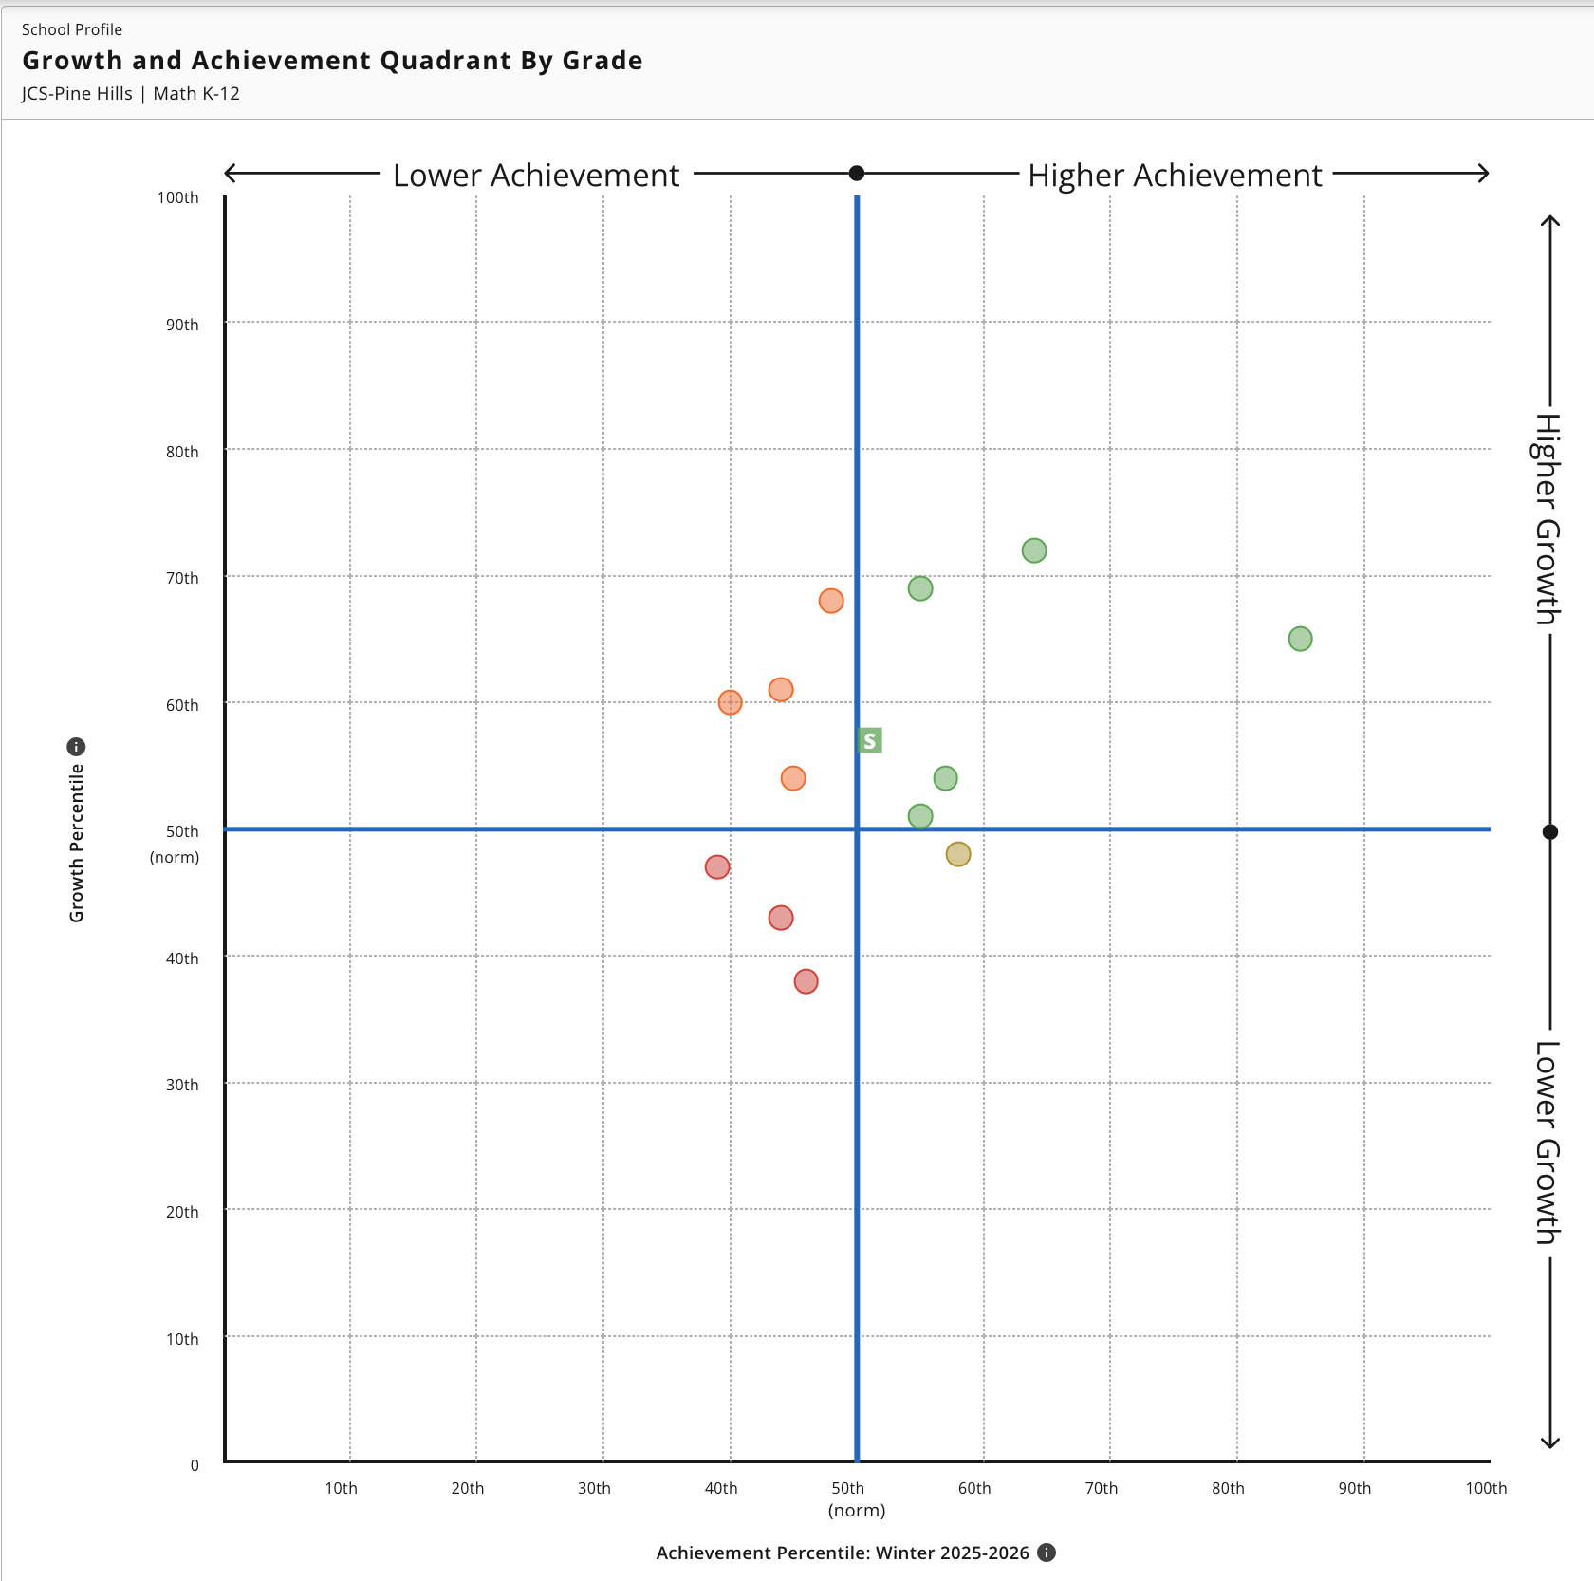
NWEA MAP Fall to Winter Growth (Math)
Math growth is above average overall: Median growth is at the 57th percentile, with nearly 46% of students above the 61st percentile, indicating solid progress across grades.
Achievement improved from Fall to Winter: Median achievement increased from the 46th percentile (Fall) to the 51st percentile (Winter), showing modest gains in overall proficiency.
Large, stable population: With 314 students, the trends reflect a reliable, schoolwide pattern—steady growth paired with gradual improvement in achievement.
9
7
8
3
K
11
5
2
1
12
10
6
4

Slide 11
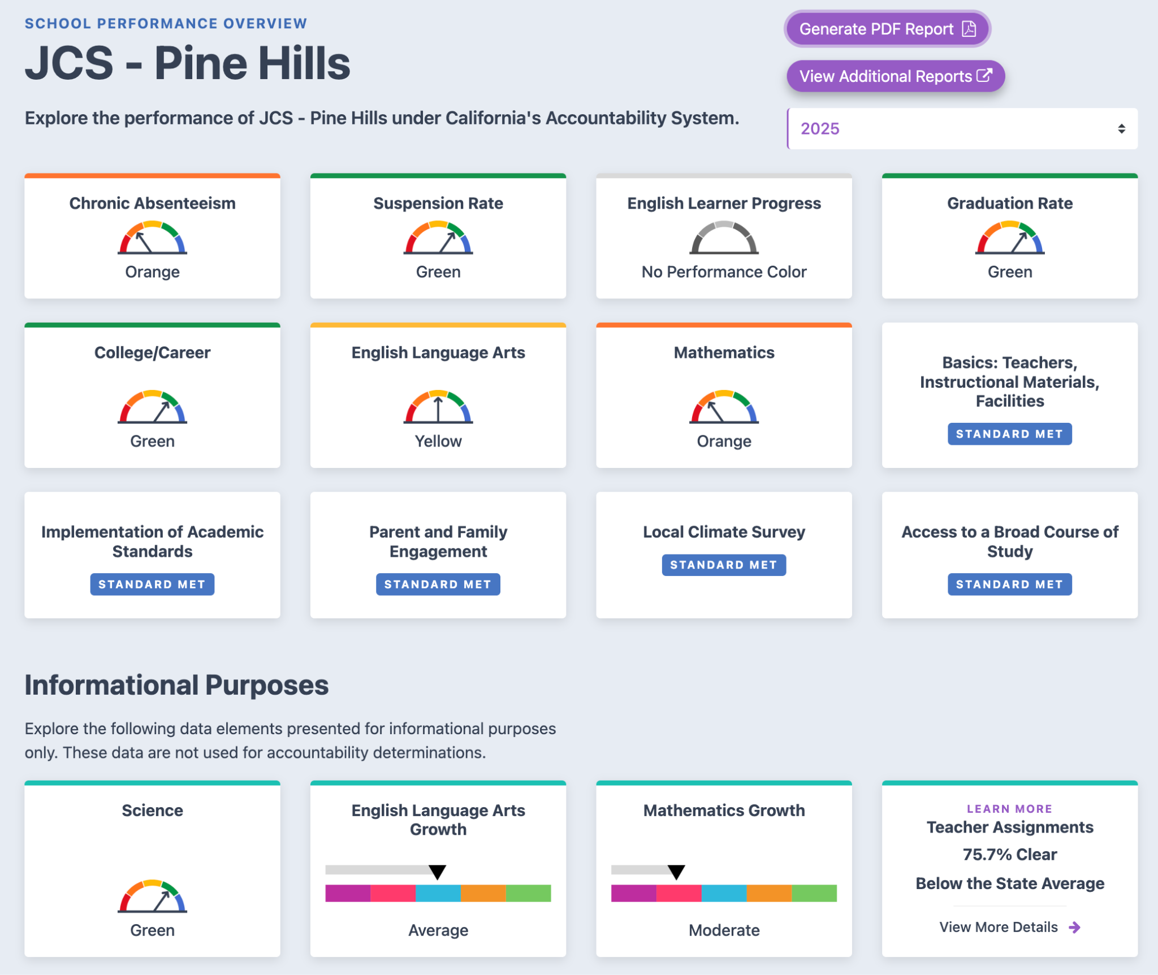
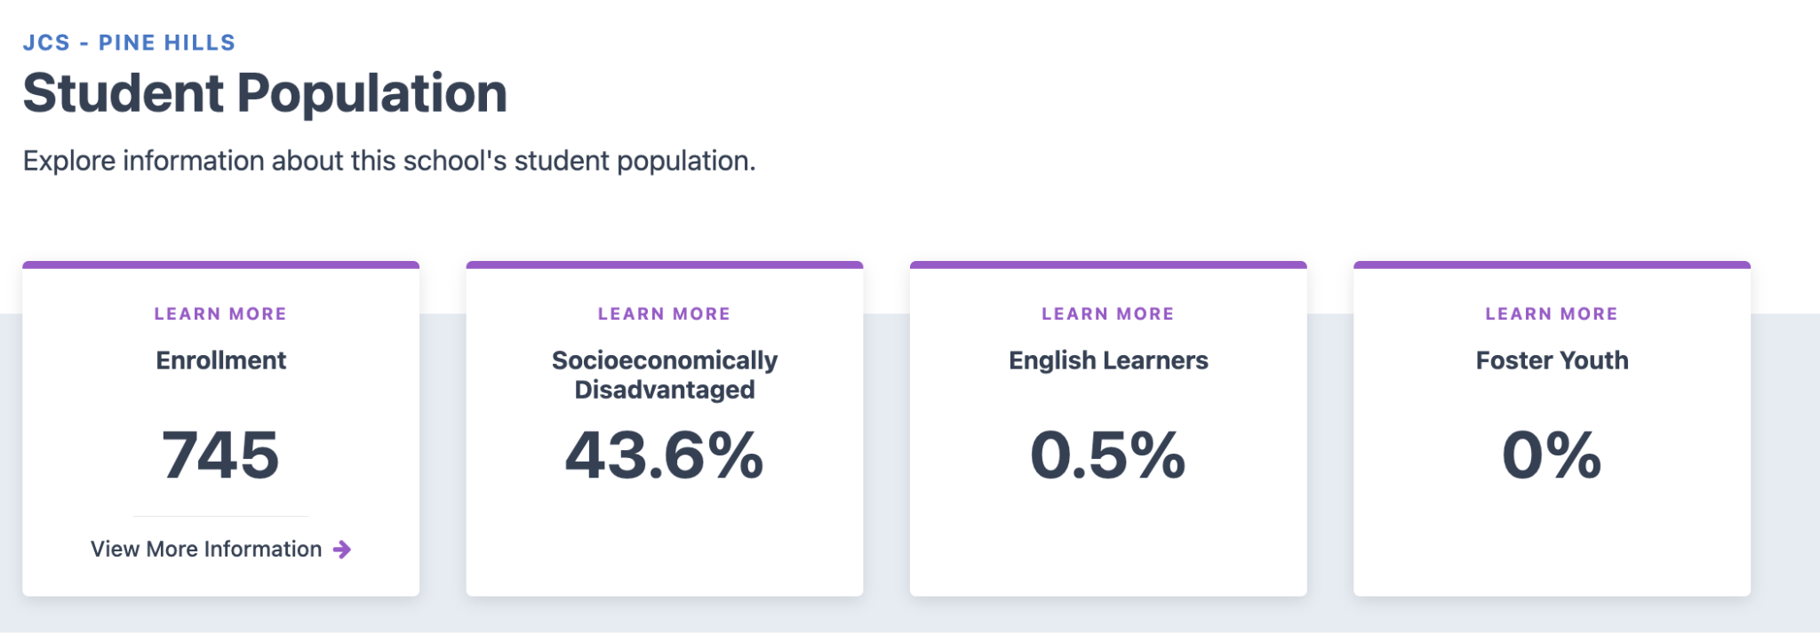

2025 CA School Dashboard
Link to 2025 Dashboard Report for JCS-PH.
Based on the 2024 & 2025 CA School Dashboards, JCS-Pine Hills is a “High” Performing charter school. Charter renewals are presumed for High Performing schools, for a term of between 5-7 years.
As a High Performing charter School, JCS-PH is among the top 16% of charter schools in California.

Slide 12
Local Control and Accountability Plan
Goal #2 - Student Outcomes
Provide high quality, equitable, and responsive instruction so that ALL students can reach their full academic potential and be well-prepared for postsecondary experiences.
Click here to access the School’s 25/26 LCAP.

Slide 13
LCAP Goal #2 - Partner Input
Instructional Quality
For Parents:
Do you feel your child’s teachers use effective strategies to help them learn?
How well does the school communicate about your child’s academic progress and learning needs?
For Students:
Do your teachers explain lessons in ways that help you understand?
Are class activities engaging and challenging enough to help you grow academically?
How often do you receive helpful feedback on your work?
For Staff:
How confident are you that your instruction meets the diverse academic and cultural needs of your students?
How often do you use data (formative, summative, or behavioral) to adjust instruction?

Slide 14
LCAP Goal #2 - Partner Input
Equity and Responsiveness
For Parents:
Do you believe the school provides equitable learning opportunities for all students?
How well does the school respond to your child’s individual academic or social-emotional needs?
For Students:
Do you feel your teachers respect and value your background, culture, and learning style?
When you need extra help, do you get the support you need to succeed?
For Staff:
How effectively do you differentiate instruction for students with varying learning needs, backgrounds, and abilities?
Do you feel supported in implementing culturally responsive teaching practices?
Are interventions and supports equitably available to students who need them most?

Slide 15
LCAP Goal #2 - Partner Input
Preparation for Postsecondary Experiences
For Parents:
How confident are you that your child is being prepared for success after high school?
Does the school provide information and guidance on post-secondary options and pathways?
For Students:
Do your classes help you feel prepared for what you want to do after high school (college, work, training, etc.)?
Are you learning skills that will help you succeed in the future (e.g., problem-solving, collaboration, time management)?
Have teachers or counselors talked with you about your post-secondary goals and how to reach them?
For Staff:
Are students given opportunities to apply learning through real-world, project-based, or interdisciplinary experiences?
How prepared do you believe your students are for post-secondary education or career pathways?

Slide 16
Comprehensive School Safety Plan
Annual Review, Update, and Approval by School Safety Committee by March 1, 2026 for 2026/2027 School Year.
School resource for preparedness, prevention, mitigation, response and recovery planning and training.
Requirements of the annual Safety Plan Process under SB 187 and the National Incident Management System.
Link to Public-Facing 25/26 CSSP (Draft) w/ Signature Page
Highlights/New Requirements
  Transferred from Google Docs to Document Tracking Services (DTS) to support JCS alignment and organization.
  NEW--Volunteers added to required Mandated Reporter Training (AB 1913)
  NEW--Emergency Procedure Accommodations for Students with Disabilities
  NEW--Procedures for Immigration Officials on School Campuses (SB 98)
  NEW--Trevor Project Hotline (LGBTQ+ Crisis Number) added to Student IDs (Grades 7-12)
  NEW--Procedures for Student Smartphone Use during Emergencies
  NEW--Emergency Operations Plan: Student Demonstration/Walkout
Are there any safety hazards you see in your workplace/school space?
Do you have any health and safety concerns which need to be addressed by the school?

Slide 17
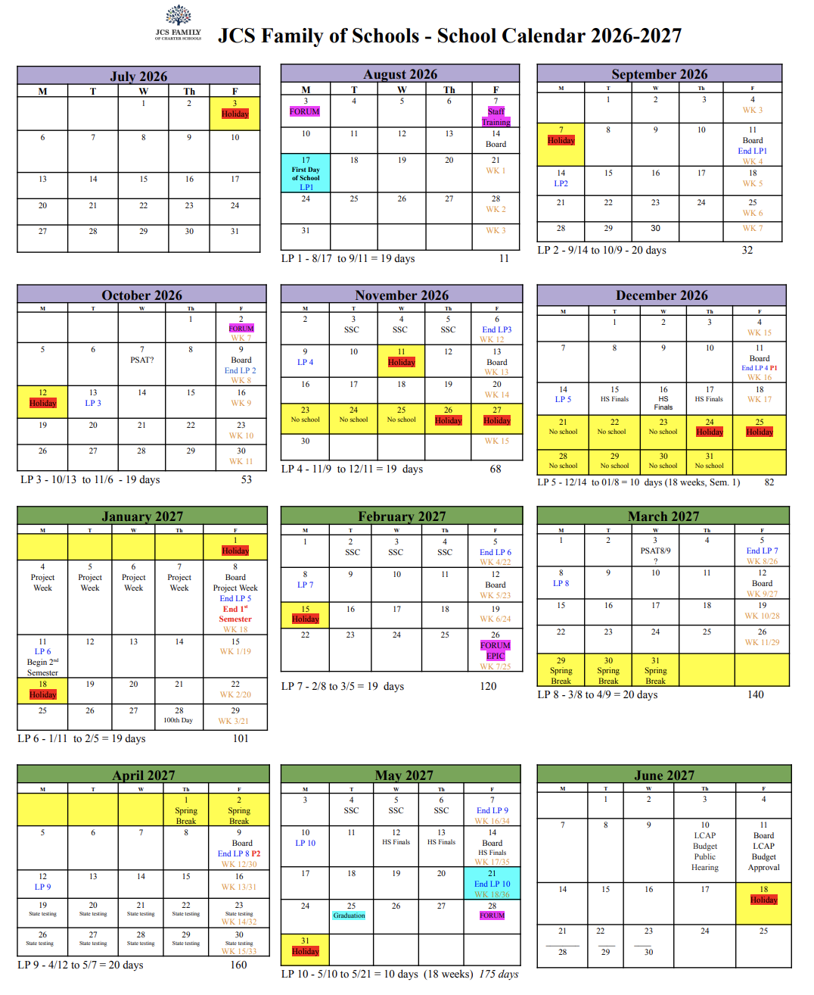
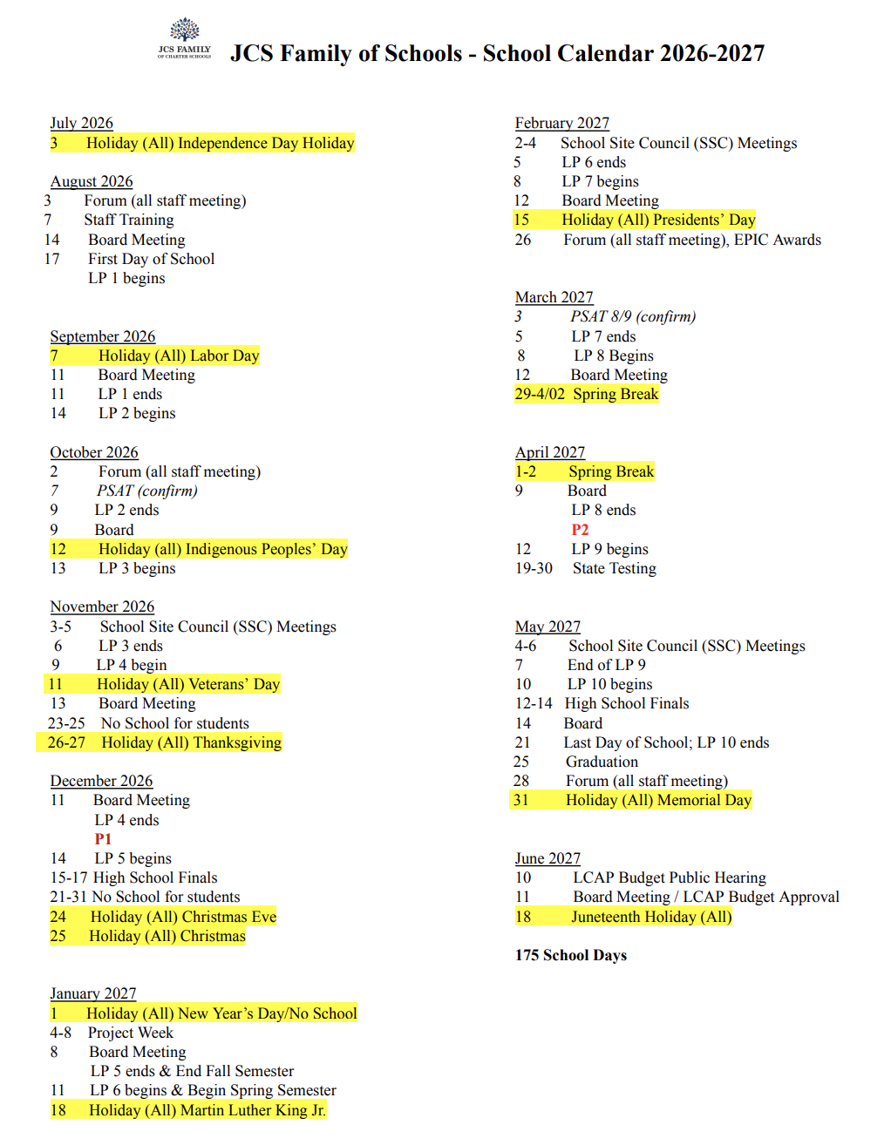
2026/2027 School Calendar

Slide 18
Charter Renewal
Renewal Petition scheduled for submission to RCBOE in February 2026
Public Hearing in March/April 2026
Renewal Vote in April/May 2026
JCS-Pine Hills is petitioning for Charter Renewal as a High Performing charter school; therefore, JCS-PH is requesting renewal for 7 years, from 2026-2033.

Slide 19
Roundtable Discussion
Is there anything else you would like to discuss?
Are there specific topics you would like to see on the next agenda?

Slide 20
Thank you!
Questions?
Jillian Tonkin, Principal
jtonkin@jcs-inc.org
Jennifer Cauzza, Superintendent
jcauzza@jcs-inc.org
Hillary Gaddis, JCS Accountability Coordinator
hgaddis@jcs-inc.org

